Slide 1

Year 12 in 2027
Information for 2025 Year 10 Students and their Parents
2025/27573

Slide 2
Guide to key abbreviations
Abbreviation | Full term
ATAR | Australian Tertiary Admission Rank
OLNA | Online Literacy and Numeracy Assessment
SRMS | Student Records Management System
the Authority | School Curriculum and Standards Authority
TISC | Tertiary Institutions Service Centre
VET | Vocational Education and Training
WACE | Western Australian Certificate of Education
WASSA | Western Australian Statement of Student Achievement
WASN | Western Australian student number

Slide 3
WACE Refreshment
Modifications are made to the WACE requirements from time to time.
This is to ensure the WACE remains a robust, rigorous and contemporary senior certificate that aligns with others across the nation and internationally.
In December 2022, the Board of the Authority initiated a WACE Refreshment process.
Notes:
The seven principles that underpin the WACE which continue to inform the WACE Refreshment are:
Learning is a lifelong process, and schooling should prepare students for multiple educational pathways.
The WACE should be flexible and accommodate students with diverse backgrounds, interests and abilities and from different learning communities.
The WACE should embed both breadth and depth of learning.
Students should engage with courses that are personally challenging, that enhance their development and maximise their future study and career options.
Marks and grades awarded should be reliable and comparable across the State and be respected as such by the Western Australian public.
After thirteen years of schooling, students should demonstrate a minimum level of literacy, numeracy and digital literacy.
After thirteen years of schooling, students should be prepared for further study in either training or university or entry to the workplace.

Slide 4
WACE Refreshment – process
The WACE Refreshments:
focus on responding to the changing landscape of education and society
acknowledge emerging demands on senior secondary education and the effects of social, economic and global conditions on young people
are ongoing and will be implemented over the coming years.
Notes:
The WACE Refreshments focus on responding to the changing landscape of education and society.
The process acknowledges emerging demands on senior secondary education and the effects of social, economic and global conditions on young people.
The WACE Refreshments are ongoing and will be implemented over the coming years.

Slide 5
WACE Refreshment – key elements
Key elements of the WACE Refreshment focus on:
the range of courses that are offered to students and how curriculum and assessment connect
the capabilities students develop and how we certify and report on student achievement
how VET and endorsed programs are recognised and used for certification
how to maximise equitable access to certification and the WACE.

Slide 6
WACE Refreshments – VET
The Board
commissioned a comprehensive report on the appropriateness of Certificate IV and Diploma qualifications contributing to WACE achievement
consulted widely with a range of stakeholders, including students, school principals across different demographics and metropolitan and regional locations, school systems and sector bodies, industry training councils, TAFE colleges, private training providers, regulatory and policy setting bodies in the training sector, and representatives from the tertiary sector.

Slide 7
WACE Refreshments – endorsed programs
The Board
commissioned a comprehensive report on endorsed programs including UDEPs contributing to WACE achievement
consulted widely with a range of stakeholders, including students, school principals across different demographics and metropolitan and regional locations, school systems and sector bodies, industry training councils, TAFE colleges, private training providers, regulatory and policy setting bodies in the training sector, and representatives from the tertiary sector.

Slide 8
WACE Refreshments – Year 12s in 2027
Two WACE Refreshments will be introduced for Year 12 students completing the WACE in 2027 relating to VET and endorsed programs. From 2027:
Diploma-level qualifications will no longer receive unit equivalence towards WACE achievement. This supports quality outcomes for students undertaking VET as part of their WACE studies.
Students selecting a Tertiary Preparation Endorsed Program (TPEP) will be required to complete at least one Year 12 ATAR course to achieve at least one unit equivalent towards WACE achievement. The decision reflects the expectation the expectation that students selecting a TPEP have aspirations for university entrance.
Notes:
TPEPs
As ATAR courses best prepare students for university study, from 2027, students who select a Tertiary Preparation Endorsed Program (TPEP – formerly known as university developed endorsed programs) will be required to complete at least one Year 12 ATAR course to receive at least one unit equivalent towards WACE achievement.
The decision reflects the expectation that students selecting a TPEP have aspirations for university entrance.
Note: the Authority will consult with schools that do not offer ATAR courses to ensure their students are accommodated.

Slide 9
The WASSA – All students
All students receive a Western Australian Statement of Student Achievement (WASSA) when they complete Year 12.
The WASSA:
formally records a student’s achievement in every course, qualification and program that the student has completed in senior secondary schooling
provides evidence of achievement.
Notes:
The WASSA is not the same as the Western Australian Certificate of Education (WACE).
As a record of student achievement, it lists as appropriate:
achievement of WACE requirements
achievement of literacy (reading and writing) standard
achievement of numeracy standard
achievement of exhibitions and awards
school grades, school marks, and combined scores in ATAR units
school grades and school marks in General and Foundation units
completed Preliminary units
completed VET industry specific units
successfully completed VET qualifications and VET units of competency
successfully completed endorsed programs
number of community service hours undertaken (if reported by the school).

Slide 10
The WACE
The Western Australian Certificate of Education (WACE) is awarded to students who have successfully completed senior secondary schooling in WACE studies and have met the WACE requirements.
The majority of students in Western Australia achieve the WACE.
Study towards the WACE can be undertaken over a lifetime.
Notes:
The WACE is recognised nationally by universities and other tertiary institutions, industry and training providers.

Slide 11
WACE requirements
Students must:
complete one of three course combination options
  complete at least four Year 12 ATAR courses OR
  complete at least five Year 12 General courses and/or ATAR courses or equivalent OR
  complete a Certificate II (or higher) VET qualification in combination with ATAR, General or Foundation courses
demonstrate the literacy and numeracy standards
meet the requirements for breadth and depth of study
meet the achievement standard.

Slide 12
Literacy and numeracy standard requirement
Students must demonstrate minimum standards of literacy and numeracy by either:
demonstrating the standard through the Online Literacy and Numeracy Assessment (OLNA); or
prequalifying in reading, writing and numeracy through the Year 9 NAPLAN and being exempted from that component in the OLNA.
Notes:
If students do not meet the literacy and numeracy standard by the time they exit secondary school, they can apply to the Authority to re-sit the assessment.
If students do not demonstrate the required standard, they will not be eligible for a WACE.
All students receive a Western Australian Statement of Student Achievement (WASSA), which records every course and program a student has completed in Years 11 and 12.
If students demonstrate the required minimum standard after they have left school, they will be awarded the WACE (assuming they have met all other WACE requirements).

Slide 13
Breadth and depth requirement
Students must complete a minimum of 20 units or the equivalent, including:
a minimum of ten Year 12 units or the equivalent
four units from an English learning area course, post-Year 10, including at least one pair of Year 12 units from an English learning area course
one pair of Year 12 units from List A
one pair of Year 12 units from List B.
Notes:
Students must complete a minimum of 20 units or the equivalent, including:
a minimum of ten Year 12 units or the equivalent
four units from an English learning area course, post-Year 10, including at least one pair of Year 12 units from an English learning area course (English, Literature, English as an Additional Language or Dialect)
one pair of Year 12 units from List A (arts/languages/social sciences)
one pair of Year 12 units from List B (mathematics/science/technology).
The breadth requirement can be met through ATAR, General and Foundation courses.
The depth requirement can be met through ATAR, General, VET industry specific and Foundation courses, VET credit transfer and endorsed programs.

Slide 14
Achievement standard requirement
Students must achieve 14 C grades or higher (or equivalents) in
Year 11 and Year 12 units, including at least six C grades (or equivalents) in Year 12 units.
Notes:
Students must achieve 14 C grades (or equivalents) in Year 11 and Year 12 units, including at least six C grades in Year 12 units (or equivalents).
The achievement standard requirement can be met through ATAR, General, VET industry specific and Foundation courses.

Slide 15
Study options
Students are offered three study options which they can mix and match:
WACE courses (four course types – ATAR, General, Foundation and VET industry specific)
VET programs
endorsed programs.
Notes:
Students may accumulate results in WACE course units, endorsed programs and VET credit transfer over a lifetime.
WACE courses include: ATAR, General, Foundation and VET industry specific courses.
Eligible students may enrol in Preliminary units, but these are not WACE courses.
For students working towards the WACE over multiple years then the WACE requirements that apply to these students are determined by the WACE requirements in place for their final year of study.

Slide 16
Sample study program – Jen
Jen enjoys puzzles and problem solving and wants to study architecture or engineering at university. She loves being part of a team and wants a career that will combine her creative and critical thinking skills.
Year 11
AECHE | Chemistry
AEDES | Design
AELIT | Literature
AEMAM | Mathematics Methods
AEMAS | Mathematics Specialist
AEPHY | Physics
Year 12
ATCHE | Chemistry
ATDES | Design
ATLIT | Literature
ATMAM | Mathematics Methods
ATMAS | Mathematics Specialist
ATPHY | Physics
Notes:
These sample programs provide examples of course combinations for different pathways to further study and training. They are not exhaustive.

Slide 17
Sample study program – Tim
Tim is also thinking about a career in architecture in the long term, but he is planning to go to TAFE to get a qualification in drafting first. Tim does not need an ATAR, but he wants to try some ATAR courses.
Year 11
AEDES | Design
AEMAA | Mathematics Applications
GEAIT | Applied Information Technology
GEENG | English
Cert II | Building and Construction
ADWPL | Workplace Learning (2 unit equivalents)
Year 12
ATDES | Design
ATDES | Mathematics Applications
GTAIT | Applied Information Technology
GTENG | English
Cert II | Building and Construction
ADWPL | Workplace Learning (2 unit equivalents)
Notes:
These sample programs provide examples of course combinations for different pathways to further study and training. They are not exhaustive.

Slide 18
Sample study program – Alex
Alex loves food and cooking and plans to follow that passion into a career. He likes thinking on his feet and feels he is suited to a fast-paced restaurant kitchen. Alex is aiming for an apprenticeship and enrolment at a TAFE after school.
Year 11
GEELD | English as an Additional Language/Dialect
GEFST | Food Science and Technology
GEHEA | Health Studies
GEMAE | Mathematics Essential
GESIP | Science in Practice
ADCS | Community Service (two unit equivalents)
Year 12
GTELD | English as an Additional Language/Dialect
GTFST | Food Science and Technology
GTHEA | Health Studies
GTMAE | Mathematics Essential
GTSIP | Science in Practice
ADCS | Community Service (two unit equivalents)
Notes:
These sample programs provide examples of course combinations for different pathways to further study and training. They are not exhaustive.

Slide 19
Sample study program – Michael
Michael likes food and entertaining, but food preparation is not his strong suit. While he’s thinking about a career in hospitality, he doesn’t know whether he wants to go to TAFE or straight to work.
Year 11
GEENG | English
GEMMS | Marine and Maritime Studies
GEMUS | Music
GEREL | Religion and Life
Cert II | Hospitality
ADWPL | Workplace Learning (2 unit equivalents)
Year 12
GTENG | English
GTMMS | Marine and Maritime Studies
GTMUS | Music
GTREL | Religion and Life
Cert II | Hospitality
ADWPL | Workplace Learning (2 unit equivalents)
Notes:
These sample programs provide examples of course combinations for different pathways to further study and training. They are not exhaustive.

Slide 20
Sample study program – Sam
Sam likes being around people and would love to use their people skills working in an office. Sam wants to improve their literacy and numeracy skills and get ready for the workplace.
Year 11
GECEM | Careers and Employability
GEENG | English
GEHAS | Humanities and Social Sciences in Action
GEMDT | Materials Design and Technology (Wood)
GEMAE | Mathematics Essential
ADCS | Community Service (two unit equivalents)
Year 12
GTCEM | Careers and Employability
GTENG | English
GTHAS | Humanities and Social Sciences in Action
GTMDT | Materials Design and Technology (Wood)
GTMAE | Mathematics Essential
ADWPL | Community Service (two unit equivalents)
Notes:
These sample programs provide examples of course combinations for different pathways to further study and training. They are not exhaustive.

Slide 21
Sample study program – Franki
Franki wants to run his own business. He enjoys designing and making a range of clothes and looks forward to pursuing a career in fashion. Franki is confident about his creative abilities and wants to take advantage of courses that will help his entrepreneurial dreams.
Year 11
AEBME | Business Management and Enterprise
AEDES | Design
GEENG | English
GEMDT | Materials Design and Technology (Wood)
Cert II | Business
ADWPL | Workplace Learning (two unit equivalents)
Year 12
ATBME | Business Management and Enterprise
ATDES | Design
GTENG | English
GTMDT | Materials Design and Technology (Wood)
Cert II | Business
ADWPL | Workplace Learning (two unit equivalents)
Notes:
These sample programs provide examples of course combinations for different pathways to further study and training. They are not exhaustive.

Slide 22
Sample study program – Sue
Sue wants to become an archaeologist and has decided to complete a Tertiary Preparation Endorsed Program (TPEP). Taking a TPEP means Sue must complete at least one ATAR course; she has chosen five.
Year 11
AEAUS | Auslan
AECHE | Chemistry
AEGEO | Geography
AEHIA | Ancient History
AELIT | Literature
PECUP2 | Academic Literacies
PECUP3 | Mathematics
Year 12
AEAUS | Auslan
AECHE | Chemistry
AEGEO | Geography
AEHIA | Ancient History
AELIT | Literature
PECUP4 | Society and Cultural Studies
PECUP5 | Science
Notes:
These sample programs provide examples of course combinations for different pathways to further study and training. They are not exhaustive.

Slide 23
Sample study program – Dev
Dev hopes to pursue a career in public policy and is looking forward studying Arts and Humanities at university. He is choosing a TPEP with a mix of General and ATAR courses.
Year 11
AEECO | Economics
AEPAL | Politics and Law
GEENG | English
GEHEA | Health Studies
GEMPA | Media Production and Analysis
PMUFTH | FlexiTrack High (over two years)
Year 12
AEECO | Economics
AEPAL | Politics and Law
GEENG | English
GEHEA | Health Studies
GEMPA | Media Production and Analysis
PECUP5 | FlexiTrack High (over two years)
Notes:
These sample programs provide examples of course combinations for different pathways to further study and training. They are not exhaustive.

Slide 24
Sample study program – Ian
Ian wants to become a primary school teacher. He is working towards a Queen’s Scout Award and might use it as an endorsed program (four unit equivalents). His course selection starts with five WACE courses.
Year 11
AEBLY | Biology
AEENG | English
AEGEO | Geography
AEMAM | Mathematics Methods
GECFC | Children, Family and the Community
Year 12
ATBLY | Biology
ATENG | English
ATGEO | Geography
ATMAM | Mathematics Methods
GECFC | Children, Family and the Community
Notes:
These sample programs provide examples of course combinations for different pathways to further study and training. They are not exhaustive.

Slide 25
Sample study program – Elena
Elena is not sure of what she wants to do after school, so her subject selection is based on what the Year 10 courses she likes. Her plan is to do her best and be well positioned by the end of Year 12.
Year 11
GEACF | Accounting and Finance
GEBME | Business Management and Enterprise
GEENG | English
GEMAE | Mathematics Essential
ADCS | Community Service (two unit equivalents)
Year 12
GTACF | Accounting and Finance
GTBME | Business Management and Enterprise
GTENG | English
GTMAE | Mathematics Essential
ADCS | Community Service (two unit equivalents)
Notes:
These sample programs provide examples of course combinations for different pathways to further study and training. They are not exhaustive.

Slide 26
Sample study program – Lou
Lou is working towards demonstrating the literacy and numeracy standard. He is starting his course selection with Foundation units and a Certificate II VET qualification.
Year 11
FEAIT | Applied Information Technology
FECAE | Career and Enterprise
FEENG | English
FEMAT | Mathematics
Cert II | Automotive Vocational Preparation
Year 12
FTAIT | Applied Information Technology
FTCAE | Career and Enterprise
FTENG | English
FTMAT | Mathematics
Cert II | Automotive Vocational Preparation
Notes:
These sample programs provide examples of course combinations for different pathways to further study and training. They are not exhaustive.

Slide 27
Sample study program – Kim
Kim plans a career in the travel industry and wants to continue learning Punjabi as a second language. She enjoys art and is very involved in a local photography club as a recreational pursuit.
Year 11
AEENG | English
AEHBY | Human Biology
AEPSL | Punjabi: Second Language
AEVAR | Visual Arts
GEPES | Physical Education Studies
ADRP | Recreational Pursuits (two unit equivalents)
Year 12
ATENG | English
GTBME | Business Management and Enterprise
GTENG | English
GTMAE | Mathematics Essential
ADCS | Community Service (two unit equivalents)
ADRP | Recreational Pursuits (two unit equivalents)
Notes:
These sample programs provide examples of course combinations for different pathways to further study and training. They are not exhaustive.

Slide 28
Australian Tertiary Admission Rank (ATAR) courses
These courses:
are examined by the School Curriculum and Standards Authority (the Authority)
are used by the Tertiary Institutions Service Centre (TISC) to calculate a student’s Australian Tertiary Admission Rank (ATAR).
There are written examinations for all ATAR courses. Students must complete the written examination.
There are practical examinations for some ATAR courses. Students must complete both examinations in these courses.
Notes:
These courses are examined by the Authority (see Section 6 of the WACE Manual).
Student results in ATAR courses are used by the Tertiary Institutions Service Centre (TISC) to calculate a student’s Australian Tertiary Admission Rank (ATAR).
The ATAR is used to determine eligibility for university entrance.
Students seeking to achieve an ATAR will need to complete a minimum of four Year 12 ATAR courses, excluding unacceptable combinations (see Undergraduate Admission Requirements for School Leavers on the TISC website).
ATAR courses are for students who are typically aiming to go to university.

Slide 29
Completing ATAR courses
Students enrolled in a Year 12 ATAR course pair of units are required to sit the written and, if the course has one, practical examination.
Students who do not sit the examination will not:
have a course mark or grade recorded on their WASSA
receive an ATAR course report
have the pair of units completed in that year contribute towards any of the WACE requirements.
Notes:
Students who are enrolled in a Year 12 ATAR course pair of units are required to sit the ATAR course examination— even if they are only enrolled in one ATAR course.
There are both written and practical examinations for some ATAR courses.
Students who do not sit an ATAR course examination and do not have an approved sickness/misadventure application for that course, will not have the grades for the pair of units completed in that year contribute to the calculation of the Western Australian Certificate of Education (WACE).
This means, the grades for the ATAR Year 12 course will not contribute to the:
completion of a minimum of 20 units, including 10 Year 12 units
completion of at least one pair of Year 12 units from an English learning area course (if the ATAR Year 12 course was either English, Literature or English as an Additional Language or Dialect)
completion of one pair of Year 12 units from List A (arts/languages/social sciences) or List B (mathematics/science/technology)
achievement of at least 14 C grades or higher, including at least six C grades in Year 12 units
completion of at least four Year 12 ATAR courses.
Students who do not sit the ATAR course examination will not have a course mark or grade recorded on their Western Australian Statement of Student Achievement (WASSA), nor will they receive an ATAR course report.
As a consequence, a student may not meet the requirements to receive a WACE.
The Authority advises consultation with students who may be enrolled in ATAR course/s but who do not require an ATAR, to confirm that they must sit the examination for that course for it to contribute to their WACE.

Slide 30
General courses
These courses:
are not externally examined
have an externally set task (EST) which is set by the Authority
are designed for students who are typically aiming to enter further vocationally based training or the workforce directly from school.
Notes:
General courses are for students who are typically aiming to enter further vocationally based training or the workforce straight from school.
General courses may be used for alternative entry to some university courses. Information about alternative entry should be sought directly from universities.

Slide 31
Online language enrolment applications
To enrol in a WACE language course, the Authority requires all students to complete an application for permission to enrol. Students submit their language application in the student portal.
In their online language enrolment application, students will be assessed against three criteria:
Education
Residency and/or time spent in-country
Use of the language for communication outside the language classroom.
Notes:
The Authority requires all students intending to enrol in a WACE language course to complete an application for permission to enrol.
Traditionally, this application has been a paper form. Students complete their WACE language course enrolment application in the student portal.
The objective of the language enrolment process is to ensure that students with a linguistic advantage in a language are not assessed against students who do not have the same advantage. Students deemed to have a greater linguistic competency than required by the course are not permitted to enrol in that course.
The criteria for enrolment have been designed to assess the degree to which a student has had previous experience in, and exposure to, the language they wish to study.
The school will endorse their students’ applications in the Student Records Management System (SRMS) portal, then the Authority will determine each student’s enrolment status.
Students will see their WACE language enrolment status in the student portal and schools can monitor the progress of applications in the SRMS.

Slide 32
Foundation courses
These courses:
focus on functional literacy and numeracy skills, practical work‐related experience and personal skills
are not an alternative senior secondary pathway
are for students who have not been able to demonstrate the minimum standard for literacy and/or numeracy before Year 11 and who require significant support
have an externally set task (EST) set by the Authority.
Notes:
These courses provide a focus on functional literacy and numeracy skills, practical work‐related experience and the opportunity to build personal skills that are important for life and work.
Foundation courses are not designed, nor intended, to be an alternative senior secondary pathway.
Foundation courses are for students who have not been able to demonstrate the minimum standard for literacy and/or numeracy (see sub-section 1.8 of the WACE Manual) before Year 11 and are unlikely to do so before the end of Year 12 without significant levels of support.
Like General courses, Foundation courses have an EST that is set by the Authority.
From 2021, students who enrol in Year 12 Foundation courses must complete a VET Certificate II (or higher) as part of the requirement to achieve a WACE.

Slide 33
VET industry specific courses
These courses:
include a full VET qualification and mandatory workplace learning
contribute towards the WACE as course units
qualifications undertaken through VET industry specific courses can be used to meet the Certificate II (or higher) component of the WACE
the workplace learning component of the course contributes as unit equivalents towards the WACE.
Notes:
VET industry specific courses include a full VET qualification and mandatory workplace learning. VET industry specific courses contribute towards the WACE as course units.
Qualifications undertaken through VET industry specific courses can be used to meet the Certificate II or higher requirement of the WACE. The workplace learning component of the course contributes as unit equivalents towards the WACE (see Section 4 of the WACE Manual for more detail).
VET industry specific courses are for students aiming to enter further vocationally based training or the workforce straight from school.
Some VET qualifications may be used for alternative entry to some university courses. Information about alternative entry should be sought directly from universities.

Slide 34
Preliminary courses
The Authority provides Preliminary courses for students who have been identified as having a:
learning difficulty and/or an intellectual disability, and
recognised disability under the Disability Discrimination Act 1992.
Preliminary courses do not contribute to the WACE, but a student doing Preliminary courses may also undertake studies that do contribute to the WACE.
Notes:
Note: Preliminary courses do not contribute to the achievement of a WACE.
Preliminary courses provide a relevant option for students who:
are unable to progress directly to training from school
require modified and/or independent education plans.

Slide 35
Vocational Education and Training (VET)
VET is nationally recognised and enables students to gain qualifications for all types of employment, and specific skills to help them in the workplace or in further training.

Slide 36
VET contribution to the WACE
As part of the minimum WACE requirements, a student may complete a Certificate II or higher in combination with ATAR, General or Foundation courses.
Studying VET can provide up to eight units towards the number of course units students need to complete to achieve their WACE.
Students will typically enrol in four or five additional ATAR, General or Foundation courses to meet the WACE requirements.
Students who do not enrol in at least four Year 12 ATAR courses or at least five Year 12 General courses and/or ATAR courses (i.e. their program of study includes one or more Foundation course/s in Year 12) must also complete a Certificate II or higher to achieve the WACE.

Slide 37
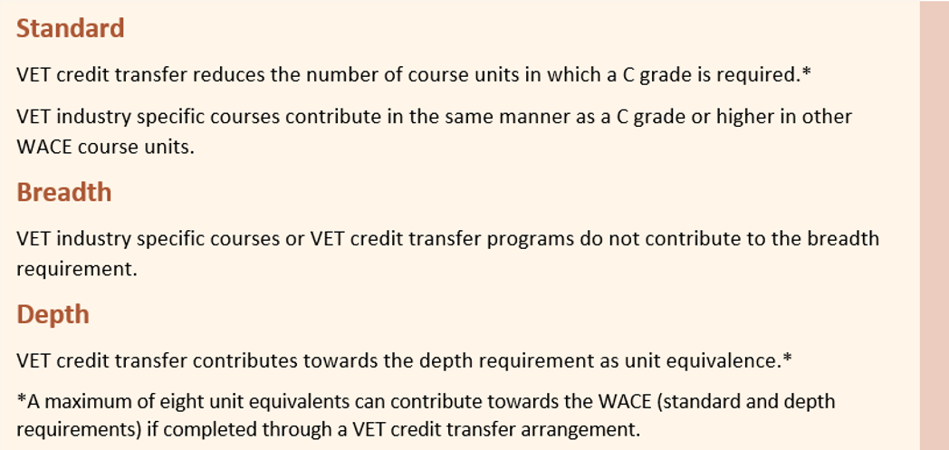
VET and the WACE
Notes:
Note: Diploma-level qualifications will no longer receive unit equivalence towards WACE achievement from 2027. This supports quality outcomes for students undertaking VET as part of their WACE studies.

Slide 38
Endorsed programs
These programs:
provide access to areas of learning not covered by WACE courses or VET programs and contribute to the WACE as unit equivalents
are for students wishing to participate in programs that are delivered in a variety of settings by schools, workplaces, universities and community organisations.

Slide 39
Endorsed programs and the WACE
Endorsed programs can be used to:
contribute towards the depth requirement and the achievement standard requirement of the WACE
count as a maximum of four unit equivalents towards the WACE – two unit equivalents in Year 11 and two unit equivalents in
Year 12.
The list of endorsed programs is available on the Authority website https://senior-secondary.scsa.wa.edu.au/syllabus-and-support-materials/endorsed-programs.
Notes:
Endorsed programs may replace up to two Year 11 course units and two Year 12 course units students need to achieve the WACE.
The list of endorsed programs is available on the Authority website https://senior-secondary.scsa.wa.edu.au/syllabus-and-support-materials/endorsed-programs.
Remember: as ATAR courses best prepare students for university study, from 2027, students who select a Tertiary Preparation Endorsed Program (TPEP – formerly known as university developed endorsed programs) will be required to complete at least one Year 12 ATAR course. The decision reflects the expectation that students selecting a TPEP have aspirations for university entrance. Note: the Authority will consult with schools that do not offer ATAR courses to ensure their students are accommodated.

Slide 40
Categories of endorsed programs
There are four categories of endorsed programs, which differ in respect to the developer, the type of evidence required for determining student achievement and the quality assurance process.
These categories are:
Authority-developed endorsed programs
Provider-developed endorsed programs
School-developed endorsed programs
Tertiary preparation endorsed programs.
Notes:
Authority-developed endorsed programs
These endorsed programs are developed by the Authority to provide WACE recognition for students undertaking activities of a similar nature, and for which no quality-assured certificate or award is issued. Authority-developed endorsed programs may be offered by any school.
Evidence of the successful completion of Authority-developed endorsed programs is contained in a portfolio that is assessed by the school and subject to the Authority’s quality assurance processes.
Provider-developed endorsed programs
These endorsed programs are developed by a private provider, such as a university, community organisation or training institution. Provider-developed endorsed programs recognise structured learning programs that result in the attainment of a quality-assured certificate or award. Provider-developed endorsed programs are open to all schools.
Evidence of the successful completion of Provider-developed endorsed programs is the provider’s quality-assured certificate or award.
School-developed endorsed programs
These endorsed programs are developed by individual schools in response to a particular need and which cannot be met through a WACE course, a VET qualification or another endorsed program.
Evidence of the successful completion of School-developed endorsed programs is through school-based assessment that is subject to the Authority’s quality assurance processes.
Tertiary preparation endorsed programs
These endorsed programs are developed by tertiary education providers, such as a university. Tertiary preparation endorsed programs recognise structured learning that result in the attainment of a quality-assured certificate and achievement which may enable students to be prepared for future tertiary studies.
Authority Developed Workplace Learning (ADWPL)
ADWPL is an Authority‐developed endorsed program that is managed by individual schools. To complete this program, a student works in one or more real workplace/s to develop a set of transferable workplace skills.
Students may accrue a maximum of two Year 11 units and two Year 12 units in Workplace Learning to contribute towards their WACE.

Slide 41
Changing courses in Years 11 and 12
The Authority publishes dates about changing enrolments in its Activities Schedule.
There are points in the semester after which students should not change courses because it would be unlikely they could complete the assessment program.
Notes:
The Activities Schedule is published on the Authority website.

Slide 42
Changing courses and withdrawing from courses
Changing means students replace one course enrolment with another.
Withdrawing means students are no longer studying a course.
If students withdraw from a course in Year 12, their enrolment course for the year is not recorded on their WASSA. This means no credit is given for the work done for the year’s units prior to dropping the course.

Slide 43
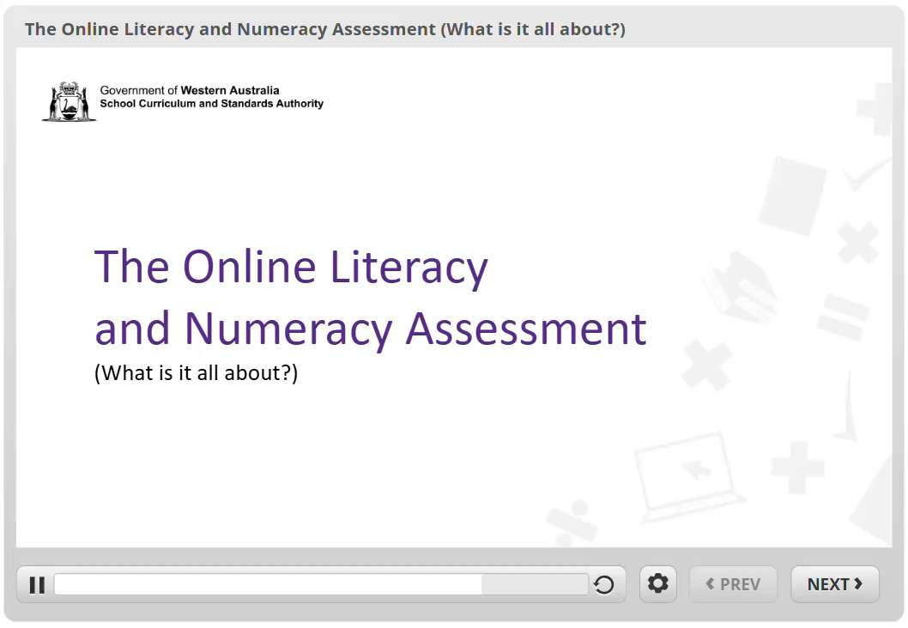
OLNA video
Notes:
A student who achieves the required level or higher in the reading, writing or numeracy component of the Year 9 NAPLAN, will be considered to have prequalified for that component.
The OLNA has three components – reading, writing and numeracy.
Students have five windows in each of Years 10, 11 and 12 to sit the OLNA. (Year 10 students have one additional window. This occurs in Term 4 of Year 9.)
It is compulsory for students to sit the numeracy, reading and/or writing components twice in Year 10 (if a students sits in the Year 9 Term 4 window this will count as their first Year 10 sit).
If students do not meet the standard in Year 10, then they must sit in Semester 1 of Year 11.
From then on, and if required, students may choose when next to sit the assessment. Students will have up to six opportunities before completing Year 12, to demonstrate the WACE minimum standard of literacy and numeracy.
Students will be required to satisfy both the reading and writing components in order to demonstrate the minimum WACE literacy standard.
Full details regarding the OLNA can be found at http://www.scsa.wa.edu.au/internet/Senior_Secondary/OLNA.
International and mature-age students are required to sit the test in either of the first two windows that is available to them. Students with disability who choose not to sit the assessment will not qualify for the WACE.
Support documents to assist teachers in preparing their students for assessment and for supporting those who have not demonstrated achievement at the minimum standard are available on the Authority website.

Slide 44
Literacy and numeracy standards
Meeting these standards:
is a benchmark of educational achievement
is valued by employers and post-school training providers
ensures all students leave school with the best chance of future success.

Slide 45
OLNA disability adjustments
Adjustments will be made to the OLNA conditions, if a student’s access to the assessment is significantly affected by a disability, impairment, illness or impediment.
Evidence of a disability, diagnosed by a specialised medical professional, is required for adjustment.
The Guidelines for equitable access for assessments is available on the Authority website at https://senior-secondary.scsa.wa.edu.au/assessment/disability-adjustment-guidelines.

Slide 46
OLNA — Typical adjustments
Adjustments typically requested for approval by principals include:
rest breaks and provision for a pause button
extra time to work
a reader
scribe assistance for the writing component
use of a support person for the reading and numeracy components
special formats.

Slide 47
Support — Literacy and numeracy standard
Assistance is available through:
Foundation courses designed for students who require significant support
feedback to schools on individual student performance for each OLNA component.
Students who have achieved the minimum standard of literacy and/or numeracy through the OLNA, are not eligible to enrol in Foundation courses.

Slide 48
The courses our school is offering
<<school to insert>>

Slide 49
The programs our school is offering
<<school to insert>>

Slide 50
WACE Checker
The WACE Checker is a tool that Year 12 students can use to check their progress towards meeting the requirements of the WACE.
It is designed to determine whether students have met (or are expected to meet) each of the requirements for the WACE.
The WACE Checker is easy to use.
The WACE Checker is available at https://wacechecker.scsa.wa.edu.au/ .

Slide 51
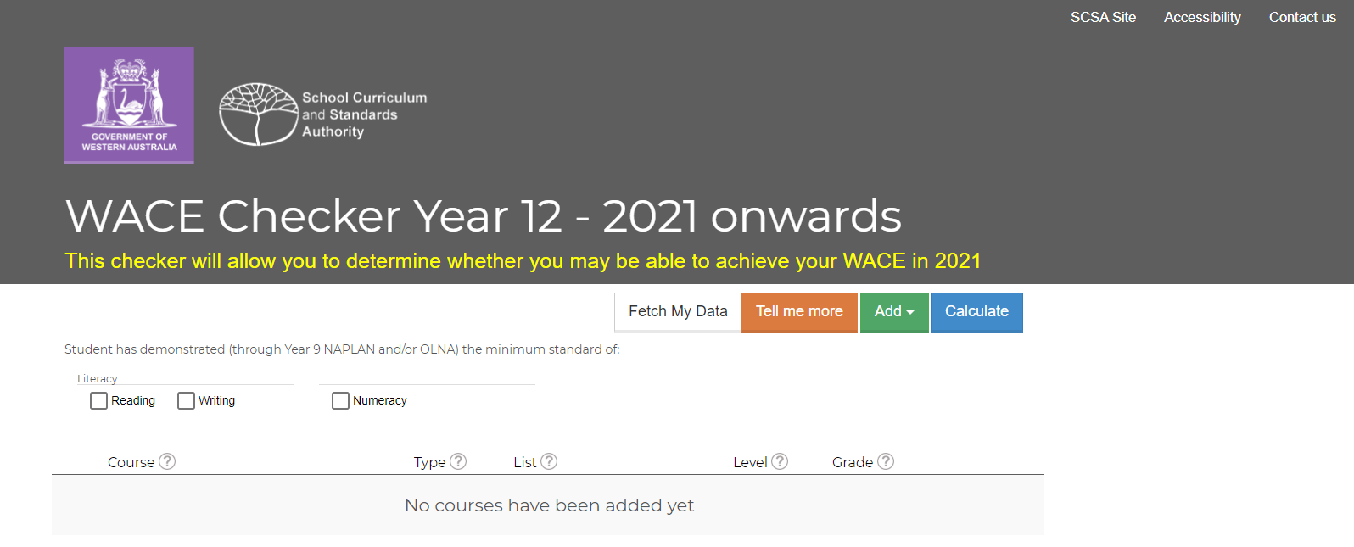
WACE Checker – Start Screen
Notes:
We encourage schools to share awareness of the tool with their Year 12 students.
Students can use it at home with their parents, or at school in conjunction with year coordinators or school admin staff if they are considering making changes to their education program.
There is a shared responsibility with the school and the student to ensure students remain WACE eligible should they make changes to the learning program and/or to monitor their grades.
Students enter information about their enrolments and achievements, the WACE Checker generates a report that shows progress towards WACE achievement.
Students can save the information, print it, email it to one or more people and if required, access the information at a later date to make changes.
For example, every year, students do not achieve their WACE because they don’t have a List B subject, or enough unit equivalents. This could be avoided by using the WACE Checker if students are seeking to make changes to their education program that may affect their WACE achievement.

Slide 52
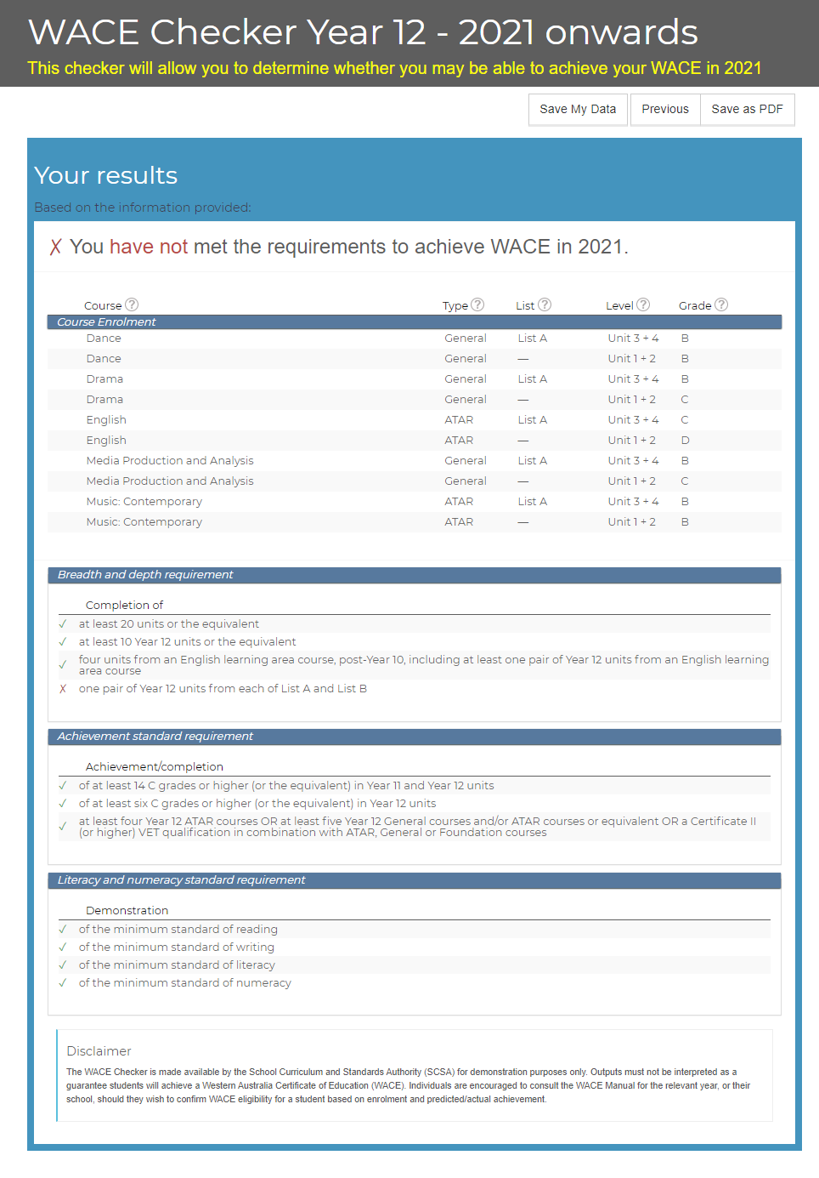
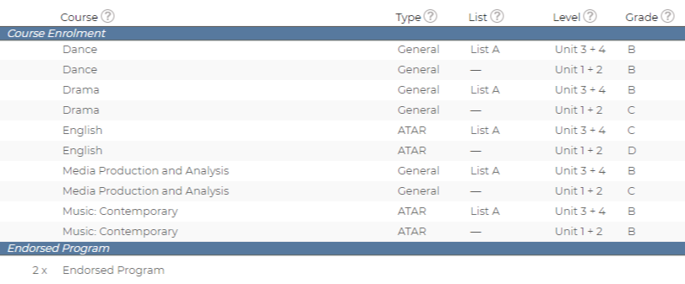
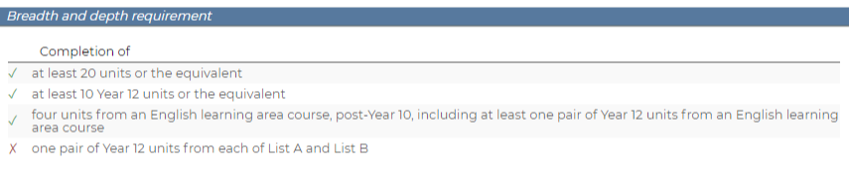
WACE Checker – Summary

Slide 53

Information for students

Slide 54
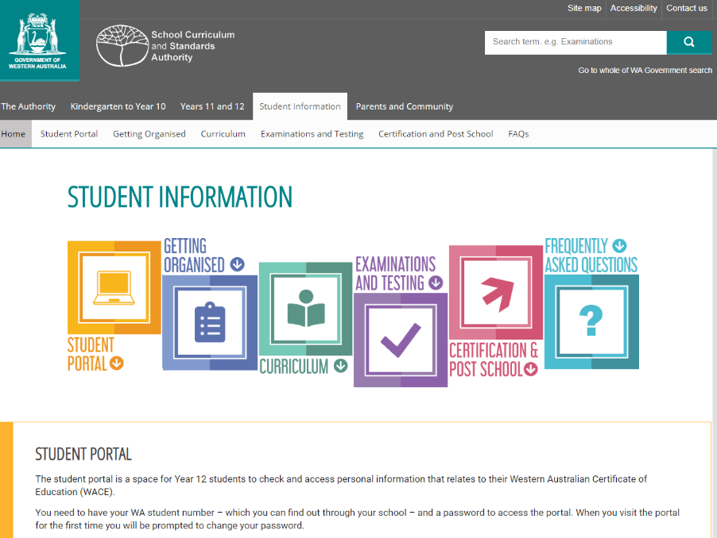
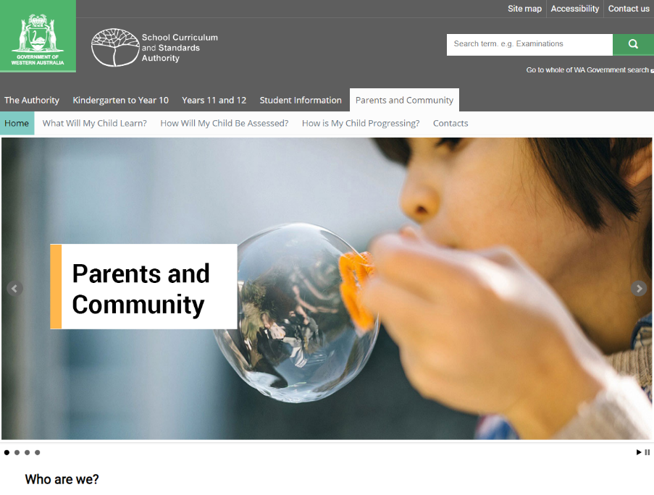
Websites for students and parents
Notes:
Student Information website
The student site provides students with easy access to information under the headings of:
Student Portal
Getting Organised
Curriculum
Examinations and Texting
Certification and Post-School
Frequently Asked Questions (FAQs).
The student site currently focuses on Year 12s and links closely to the Year 12 Information Handbook 2020, Part I. The handbook is available at https://www.scsa.wa.edu.au/publications/year-12-information.
Parents and Community website
The Parent and Community website can now be accessed on the Authority website https://www.scsa.wa.edu.au via the Parents and Community tab.
The parent site provides information about what children and young people should learn, how they are assessed and the standards they are expected to reach at each year level, from Kindergarten to Year 12. The site will continue to be refined and developed over time.
The parent site has been developed for parents and community members as a guide to:
the Western Australian Curriculum and Assessment Outline (the Outline), Kindergarten through to Year 10
the Western Australian Certificate of Education (WACE), Years 11 and 12.
Parents and the community can access information about:
what children and young people should learn
how they are assessed
the standards children and young people are expected to reach at each year level.

Slide 55

Links
 | www.scsa.wa.edu.au
 | info@scsa.wa.edu.au
 | https://facebook.com/SCSAWA
e

Slide 56
© School Curriculum and Standards Authority, 2025
This document—apart from any third party copyright material contained in it—may be freely copied, or communicated on an intranet, for non-commercial purposes in educational institutions, provided that the School Curriculum and Standards Authority is acknowledged as the copyright owner, and that the Authority’s moral rights are not infringed.
Copying or communication for any other purpose can be done only within the terms of the Copyright Act 1968 or with prior written permission of the School Curriculum and Standards Authority. Copying or communication of any third party copyright material can be done only within the terms of the Copyright Act 1968 or with permission of the copyright owners.
Any content in this document that has been derived from the Australian Curriculum may be used under the terms of the Creative Commons Attribution-Non Commercial 4.0 Australia licence.
HPRM 2025/27573

