Slide 1
2017 Secondary School Leader Briefing Years 7 – 12
Notes:
Acknowledgement
The Authority could not complete the work on curriculum, assessment and standards without teachers.
Through the support of Principals, the voices of classroom teachers are reflected in all aspects of the Western Australian Certificate of Education (WACE) and the Western Australian Curriculum and Assessment Outline.

Slide 2
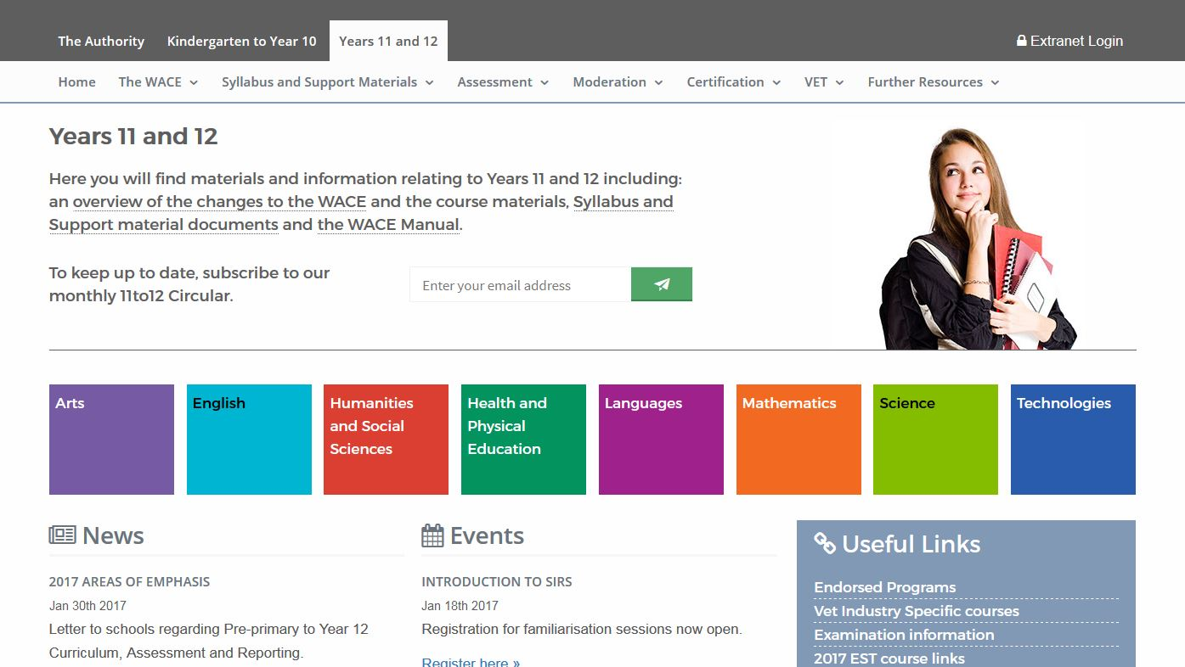
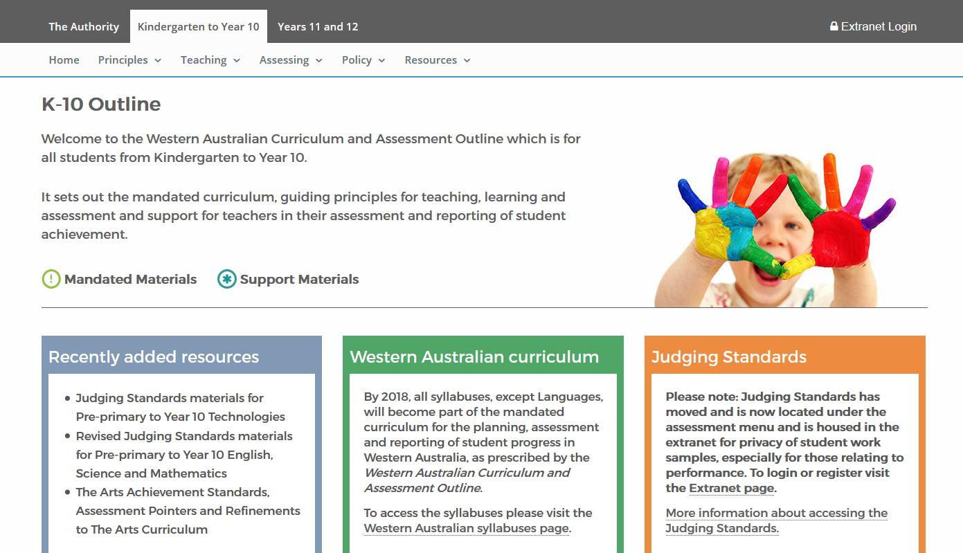
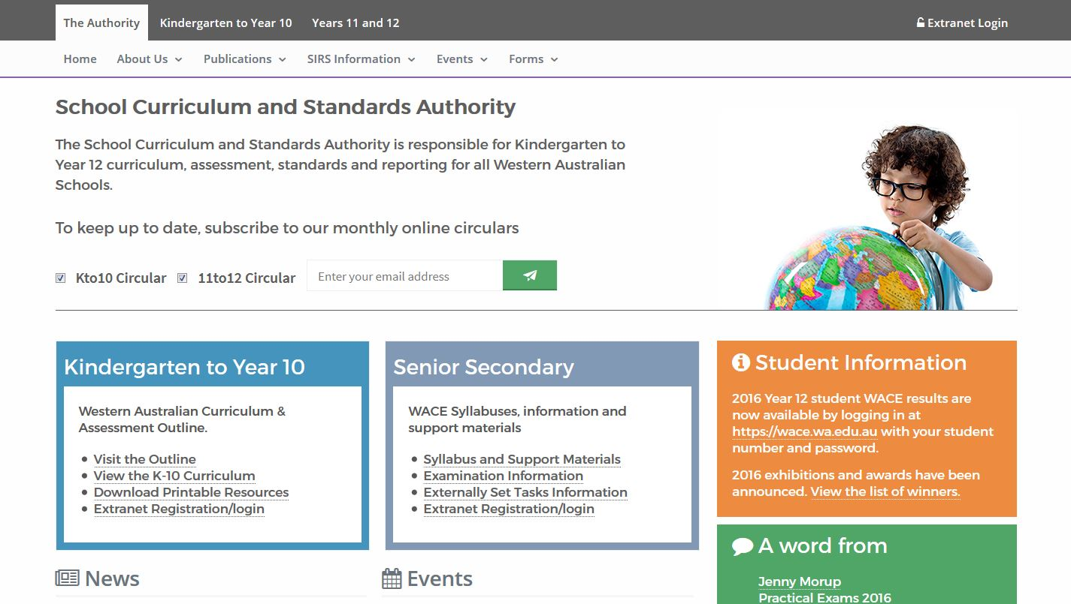
What’s on the Authority website
Notes:
The School Curriculum and Standards Authority website (www.scsa.wa.edu.au) has recently been revamped based upon feedback from teachers.
A parent site will shortly be launched. This will communicate information in parent-friendly language. Information on the parent site will be progressively updated.
The Western Australian Curriculum and Assessment Outline sets out the mandated curriculum, guiding principles for teaching, learning and assessment and support for teachers in their assessment and reporting of student achievement.
Note that in the Western Australian Curriculum and Assessment Outline Mandated Materials are marked with an ‘Exclamation Mark’ and Support Materials are marked with an ‘Asterisk’.
The Years 11 and 12 section of the website holds all of the information relating to the Western Australian Certificate of Education.

Slide 3
2017 Briefing for School Leaders

Slide 4
2016 WACE
2016 resulted in 21 473 students receiving a WACE and 25 338 students receiving the Western Australian Statement of Student Achievement (WASSA).
We sincerely thank you and your staff for your commitment to ensure that Western Australia’s 2016 Year 12 student cohort was so well supported.
Notes:
2016 Year 12 students were the first cohort who completed their studies under the revised WACE.
A BIG THANK YOU to our colleagues in schools who ensured students were so well supported.

Slide 5
2016 WACE Statistics
In 2016:
25 441 Year 12 students undertook studies towards the WACE
23 360 full-time students were eligible to achieve a WACE
21 473 (91.9 per cent) of eligible Year 12 students achieved a WACE
13 540 Year 12 students studied four or more ATAR courses
validation of the number of ‘C grades’ awarded in General courses.
Notes:
Allan
Refer to the principles of that underpinned the WACE reform and how we are pleased that based on what we know has occurred in 2015 and 2016 we are moving in the right direction, but we still have a lot to do.
Positives:
students enrolled in appropriate and challenging courses
increased number of students enrolling in VET
raised standards in literacy and numeracy
those students who have low levels of literacy and numeracy skills are being identified and supported. This though should be being identified earlier by schools. Refer to the literacy and Value-Adding achieved in schools comparing Year 9 to Year 12 Literacy and Numeracy achievement of AQSF 3.
Overall Statistics
In 2016, 25 441 Year 12 students undertook studies towards the WACE. This is an increase of 2.19 per cent on the 24 895 students in 2015.
Of the 25 441 Year 12 students (24 895 in 2015), 23 360 full-time students were eligible to achieve a WACE (23 475 in 2015).
In 2016, 21 473 (91.9 per cent) of eligible Year 12 students achieved a WACE. This compares to 22 630 (96.4 per cent) in 2015.
ATAR courses: There were 13 540 Year 12 students (58.0 per cent of Year 12 students who undertook full-time studies towards the WACE) who sat four or more ATAR course examinations in 2016. In 2015, there were 13 680 Year 12 students (58.3 per cent) who sat four or more ATAR course examinations.

Slide 6
2016 WACE Statistics
Growth of VET
140 schools had 100% of their students complete a Certificate II or higher.
In 2016:
13 971 Year 12 students achieved at least one VET qualification in Year 10, 11 or 12
13 547 Year 12 students achieved at least one VET qualification at Certificate II or higher in Year 10, 11 or 12
3 408 students achieved Certificate III
674 students achieved a Certificate IV
approximately 15 000 students completed Workplace Learning programs.
Notes:
VET
There were 140 schools that had 100% of their students, not enrolled in four or more ATAR courses, complete a Certificate II or higher.
In 2016, 13 971 Year 12 students achieved at least one VET qualification in Year 10, 11 or 12, compared with 11 796 in 2015.
In 2016, 13 547 Year 12 students achieved at least one VET qualification at Certificate II or higher in Year 10, 11 or 12, compared with 10 843 in 2015.
In 2016, there were 4 082 Certificate III or IV achieved. Comparative figures for 2015 were 2 825. In 2016, 3 408 students achieved Certificate III and 674 students achieved a Certificate IV. The respective numbers in 2015 were 2 345 and 480.

Slide 7
2016 Year 12 ATAR Examination Means
All examinations
Mean: 62.63 Standard Deviation: 13.15
Written examinations
Mean: 60.89 Standard Deviation: 12.81
Practical examinations
Mean: 64.37 Standard Deviation: 13.49
Notes:
Feedback on the 2016 ATAR Course Examinations
Feedback received after the 2016 ATAR courses examinations
Teacher/Examiner Forums completed
Responding to feedback

Slide 8
2016 ATAR Course Examination Means
Mean, StdDev, minimum and maximum of each 2016 ATAR course examination

Slide 9
2016 Externally Set Tasks (ESTs) Feedback provided to schools

Slide 10
EST – mean school mark vs mean SCSA reviewer mark
Maximum possible marks = 41
Your mean mark = 21.00
Reviewers mean mark =20.17

Slide 11
EST – mean school mark vs mean SCSA reviewer mark
School’s mean mark > Reviewer’s mean mark
Teacher’s marks may have been lenient

Slide 12
EST – mean school mark vs mean SCSA reviewer mark
School’s mean mark < Reviewer’s mean mark
Teacher’s marking may have been too hard

Slide 13
EST – mean school mark vs mean SCSA reviewer mark
Consistent understanding of marking standards
School mean for selected scripts < State mean

Slide 14
EST – mean school mark vs mean SCSA reviewer mark
Consistent understanding of marking standards
School mean for selected scripts near State mean

Slide 15
EST – mean school mark vs mean SCSA reviewer mark
Consistent understanding of marking standards
School mean for selected scripts > State mean

Slide 16
EST – Reflective Questions
Has the content from the syllabus been covered as outlined in the 2017 EST Unit 3 content document provided to schools in Term 2, 2016?
The pitch of the Unit 3 and 4 courses in General units has been raised. Do you need to seek further clarification on the pitch of the course content?
Has the marking key provided by the Authority been followed?
Did you undertake internal comparability where more than one teacher is delivering the course?

Slide 17
Gentle Reminders and Points of Clarification
WACE achievement – check using SIRS report CSE015
Informing students
Spelling of names and incorrect addresses
WACE achievement – VET results
Exhibitions and Awards
Student declaration and permissions – check using CSE058
Language eligibility process
Use of textbooks
2017…. the year of getting the requirements right
Notes:
2017 is a year of consolidating the implementation of the new WACE reforms.
Here are some particular areas that the Authority would like to draw your attention to.
Achievement of WACE
Some students contacted the Authority because they were not aware that they were not going to achieve the WACE or because their school had forgotten to upload their VET qualification to SIRS. This impacted on some students receiving first round offers from TISC and TAFE admissions in January
Following the release of results, the Authority was made aware that some students were not informed by their schools that they had not achieved the WACE. These students found out when they logged onto the student portal (via https://wace.wa.edu.au) on 28 December 2016.
Students need to be aware of the difference between school graduation and the achievement of the WACE.
How can a school monitor the achievement towards the WACE?
Report available in SIRS – WACE Eligibility – Students not achieving WACE (CSE015).
Schools are able to run this report to see the status of WACE achievement for each student. The criteria for the WACE is listed and Yes/No against each criteria.
Schools need to be vigilant in checking their Year 12 student data, in particular:
Residency status –
Many students missed out on awards in 2016 as their residency status was incorrect in SIRS.
Students on a certain visa sub-class are not considered permanent residents for the purpose of receiving awards from the Authority.
SP - It can also impact on ATAR calculations for students on a 444 special category visa from New Zealand, as the Authority does not recognise this visa as resident. However, TISC acknowledges, New Zealand students as being resident for ATAR calculations.
Student addresses –
Schools need to upload the correct postal address in SIRS when updating the street address. There was a large number of return certificates. In contacting students, the Authority was told that they had advised the school.
SP – schools may update residential address and forget to update the postal address.
Spelling of student names –
Schools need to ensure that the correct spelling of students’ names are uploaded correctly. Students and parents contacted the Authority regarding the incorrect spelling of certificate names.
Student declaration and permissions –
Last year we had the highest number of students who did not complete the online student declaration and permission.
All Year 12 students, not only ATAR students, need to complete the declaration and permission process.
Schools are able to run a report in SIRS to determine which students have or have not completed the process. This can be checked via CSE058 – Student Release Choices by Provider (pathway to generate report - Reports > other reports, report type: students > CSE058).
Schools need to encourage their students to complete the process. A consequence of not doing this, is that students’ names did not appear in the awards listing which is published on the Authority website and in the media.
Schools are also encouraged to provide these dates to a RTOs via multiple sources to ensure that the deadlines are understood by all relevant RTO personnel.
Schools should notify the Authority as early as possible if it is foreseen that there may be issues with receiving results from an RTO in time for reporting deadlines at: dataservices@scsa.w.edu.au.
Year 12 VET result reporting deadlines
2017 VET results for Year 12 students are due by November 1.
Last changes to course results via SIRS can only be made by schools up until November 17, however schools have up until the 29 November to make changes to Year 12 VET results.
VET results upload files
It is imperative that schools ensure that both the VET achievement files Result: VET units of competency and Result: VET qualifications are uploaded to the SIRS database when a student completes a qualification. The information in the Results: VET qualification file is used to allocate unit credit towards the WACE and to determine that a student has met the Certificate II or higher requirement.
Issue: Exhibitions and Awards
Incorrect residency status in SIRS.
Certain visa sub-class are not considered permanent residents.
Student declaration and permissions
Highest number of students who did not complete the online student declaration and permission.
All Year 12 students need to complete the declaration and permission process.
Students miss out on the opportunity of being recognised in the liftout published on the Authority’s website and in The West Australian.
Use of textbooks
the syllabus is the mandated content
there are no endorsed textbooks
there are set texts in some courses
teachers should identify relevant sections of each text … they should be selective.

Slide 18
2017 Briefing for School Leaders

Slide 19
2017 WACE Revised Requirements and Deadlines
Revised requirements to achieve a WACE in 2017:
Year 12 ATAR students must sit the ATAR course examination – consequences for meeting WACE requirements
students must complete four units from an English course, post-Year 10, including at least one pair of Year 12 units from an English course.
Keep up-to-date with the Authority’s Activities Schedule
http://www.scsa.wa.edu.au/publications/wace-activities-schedule
Notes:
Any student enrolled in Year 12 ATAR courses (Units 3 and 4) must sit the ATAR course examination in that course. If they do not sit the ATAR examination (and do not have approved sickness/misadventure application for not sitting the examination):
the pair of units completed in that year will NOT contribute towards any of the WACE requirements
the course mark or grade will not be recorded on their WASSA
they will not be issued with an ATAR course report.
Students must complete four units from an English course, post-Year 10, including at least one pair of Year 12 units from an English course.
Activities Schedule
The schedule will be available, on a term basis (at the beginning of each term), for download into Outlook calendars.
If you “like” the Authority Facebook page for teachers, you will be receive reminders prior to due dates.
Thursday, 2 March: Year 11 and 12 enrolments into SIRS
Due date for upload into SIRS - enrolments for Year 11 and Year 12 students studying units in ATAR, General, Foundation, Preliminary and VET industry specific courses.
Wednesday, 5 April
Last date for upload into SIRS – changes to enrolments in:
ATAR, General, Foundation, Preliminary and VET industry specific courses for Year 12 students
ATAR (Units 3 and 4) courses for Year 11 students.
Note: After this date, this SIRS facility will be locked and no further changes (except withdrawals) will be accepted.
Enrolments – Transferring Between Courses
Transfers up until Wednesday, 5 April.
Withdrawal only up until Friday, July 28 – practical examination courses or Friday, 25 August for all other Year 12 courses.
After these dates, the Authority will be expecting a mark and a grade of achievement for all courses students are enrolled.
Enrolments – Withdrawing from Courses
Schools need to consider the consequences of students withdrawing from courses.
For example, is the student still able to meet the requirements to achieve the WACE?
In 2016, the Authority received applications from schools where, as a result of withdrawing from courses students:
did not have a pair of Year 12 units from List B (mathematics/science/technology)
had not completed the minimum of ten Year 12 units
no longer had four Year 12 ATAR courses and had not completed a Certificate II or higher.
In 2017, allowances will not be considered for students to be awarded the WACE in the above situations.

Slide 20
220 nominal hours rules clarified
Certificate II recognition
Partially completed Certificate III or higher
=>220 nominal hours for full allocation of unit equivalence (4 units)
Can be achieved and reported over Years 10, 11 and 12.
<220 nominal hours only Year 11 credit
Meets Cert II requirement
=>220 nominal hours of new VET in Year 12
Must be achieved in Year 12
Result of 20 (competent) only
Meets Cert II requirement
Notes:
There are two WACE rules relating to the requirement for students to complete 220 nominal hours of VET. One relates to the recognition of Certificate II qualifications and the other relates to the partial completion of a Certificate III or higher.
Completed Certificate II qualifications
The full allocation of unit equivalence is only awarded for completed Certificate II qualifications where the total achievement in units of competency is equal to or greater than 220 nominal hours (the equivalent of four course units). The 220 nominal hours can be achieved and reported over Years 10, 11 and 12.
Certificate II qualifications with units of competency that are less than 220 nominal hours in total will meet the minimum Certificate II qualification requirement, however, the qualification will only contribute towards the WACE as two Year 11 unit equivalents.
Please note: a combination of results which include 20 (competent), 60 (credit transfer) or 51 (RPL granted) can make up the minimum 220 nominal hours for a completed Certificate II.
Partially completed Certificate III or higher
To be awarded unit equivalence for a partially completed Certificate III or higher students must complete in Year 12 at least 220 nominal hours of new VET enrolments.
Please note: A result of 20 (competent) in Year 12 can only be used towards meeting the minimum 220 nominal hours for a partially completed Certificate III or higher.

Slide 21
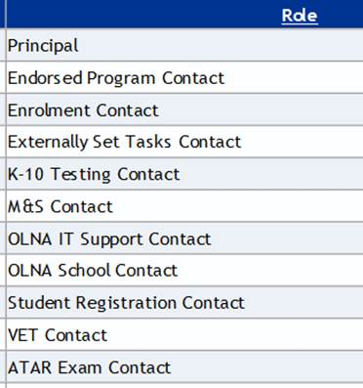
Your SIRS Contacts
Keep the Authority up-to-date
Notify us of staff on leave who are a contact person
Notes:
School Contacts
These specific roles are maintained on our SIRS database. At the beginning of each academic year, The Authority sends out a letter package and request secondary schools to send in these details. This information is then updated on the database. It is imperative that, at all times, the correct information is imparted to us as important, and sometimes URGENT communication needs to be sent to schools either for action or dissemination of information.
During the year, if and when people who hold these specific roles, either go on leave or are no longer at the school, we need to be kept informed of these changes. Details of the new person nominated by the school can be emailed to Perpetua.Joseph@scsa.wa.edu.au for updating the records.

Slide 22
2017 Briefing for School Leaders

Slide 23
Externally Set Tasks 2017
2016
Pitch
Marking keys
Scanning of the selected scripts
Review process
2017
Revised dates in Activities Schedule
Introduction of EST checker
Scanning for schools
Number of marks provided
Reviewers’ reports available
Criterion-based marking key for English as requested
Notes:
Feedback from school’s regarding the 2016 EST was:
overall positive
they received a task and marking key and will receive another in 2017. Eventually schools will have a ‘bank’ of tasks
thanked the Authority for assisting school’s by scanning the tasks for them
assisted in identifying what was expected of teachers and students by the ‘General’ and ‘Foundation’ courses.
Courses that generated some concerns with regard to the 2016 EST included:
Mathematics Essential – level of difficulty; understanding of follow-on errors
English – lack of a criterion referenced marking key.
Feedback in general included:
pitch of the EST
the interpretation of marking keys
additional workload of scanning materials
receiving the overall mark from the Authority reviewer but not seeing the breakdown of marks.
The above concerns have been addressed by:
the Authority will scan all scripts for all schools unless they notify us differently
The Authority has introduced an external checker into the EST development process who works the task and applies the marking key
double-checking by classroom teachers of courses that generated concerns
our intent to provide the breakdown of the reviewers mark this year
providing a criterion-based marking key for English.
Key Dates
10 February 2017 - School requests for EST in Braille
5 May 2017 - Schools received printed copies of EST | School nominate to scan or mail in completed ESTs
8 May 2017 - EST contact to download marking key and collection form
8 May – 26 May - Administration of EST
26 May - Schools download from SIRS which scripts to be externally reviewed
Schools upload raw marks to SIRS
9 June - Schools send to the Authority the Authority-selected scripts
16 June - Schools nominating to scan the scripts will upload files to SIRS
School holidays - Scripts marked by independent reviewers at the Authority
11 August - EST feedback available to schools via SIRS
15 September - Schools informed via Authority website of EST content for 2018

Slide 24
2017 Moderation
Syllabus delivery audit (SDA, ATAR Year 11)
New schools documentation reviews
Externally Set Task (EST, Term 2, Weeks 3 – 5)
Grading reviews for ATAR, General and Foundation courses (based on SIRS reports, SDA, ESTs or other data)
Consensus moderation (2 phases)
Notes:
Syllabus delivery audit
Third year of a 4 year cycle, Year 11 ATAR reviewers are looking for clear delivery of courses with demonstration that the assessment and course outlines reflect a genuine engagement with the context of the school. Our samples can be adapted if appropriate but must show recognition of school engagement e.g. removal of our footers, refinement of weekly schedule to reflect the 2017 school calendar.
New school documentation reviews
Schools in their first year of Year 11 or year 12 delivery have their documentation reviewed for each course. This is broader than the syllabus delivery audit and includes early tasks and marking keys. The Authority’s Curriculum, Assessment and Moderation consultants and manager also visit these schools and engage with admin and staff to support all aspects of compliance and strategies to ensure grades comparability.
Externally set task – second year for all Year 12 General and Foundation courses
Assists to ensure the fair assessment of student achievement in Year 12 General and Foundation courses.
Has an educative role in establishing common understandings among teachers of the course standards and related content.
Provides access to feedback which will encourage teachers to review and, where appropriate, adjust their marking.
Models best assessment practice which teachers can apply to other school-based assessment tasks.
Assists to inform the Authority’s other moderation activities.
Grading Reviews
Decisions to follow up with school grading review visits are based are based on data from 2016 including syllabus delivery audit, externally set task and our data analysis reports mainly STS36 which shows degree of statistical moderation and the correlation value for each Yearr 12 ATAR course for each school.
Consensus moderation
Two phases - one for Year 12 courses from 6 June 2017 – 23 June 2017 (Weeks 7 to 9 Term 2) and one for Year 11 courses from 24 July 2017 – 11 August 2017 (Weeks 2 to 4 Term 3):
participation in this moderation process is compulsory for all schools delivering a course involved in the particular year.
the teachers reflect on the feedback received from their colleagues to help determine any adjustments that may be required so that the school’s marking and grading is comparable with the standard of their colleagues in the group.
See next slide for details of courses involved.

Slide 25
2017 Consensus Moderation
Course | Course type | Course | Course type
Business Management and Enterprise | General Year 11 and Year 12 | Materials Design and Technology (all contexts) | General Year 11 and Year 12
Design (all contexts) | General Year 11 and Year 12 | Mathematics: Essential | General Year 11 and Year 12
Engineering Studies | General Year 11 and Year 12 | Music | General Year 11 and Year 12
English as an Additional Language/Dialect | Foundation Year 11 | Physical Education Studies | General Year 11 and Year 12
Health Studies | General Year 11 and Year 12
Notes:
These courses were selected based on an analysis of the 2016 data from the syllabus delivery audit, externally set task and school visits indicating that teachers of these courses needed support in clarifying standards, content pitch and developing and applying appropriate assessment tasks.
In some of these courses the Authority will be offering as a prequel to the consensus meetings Improving Student Performance Workshops that will target aspects of course delivery and assessment that are considered as ‘hotspots’ for support. E.g. in General Music it will be a seminar that targets content delivery according to the contextual needs of the students, in General Design it will be exemplification of the course delivery in the technical graphics defined context.

Slide 26
Non-Approval of Grades
Pilot year for process with Year 12
Follow-up from grading reviews
Proposed grades -vs- grading review advice
Follow-up process
Consequences and implications for the WACE
Notes:
Following school visits, the Authority expects schools to align assessments and grading with advice provided to schools on suggested cut-points for grades.
When schools submit their proposed grades if they do not follow advice provided at the visit then schools will need to provide a detailed explanation with justification why the advice has not been followed.
Schools will need to retain their records and have access to student work at short notice if the Authority chooses to revisit the school.
Follow-up visits to the school will involve the Authority’s course principal consultant and an independent moderator such as the Chair of the Course Advisory Committee.
The implications of this could include that the Authority will not accept the school grades for that course in 2018. Principals will be advised in 2017 if grades would not have been accepted.
Non-approval of school results will impact both the WASSA and the achievement of the WACE for students.

Slide 27
Online Literacy and Numeracy Assessment
Response to Online Literacy and Numeracy Assessment (OLNA) feedback:
the OLNA reading and numeracy components will have extended test windows for each round
March: 7 – 24 March
September: 28 August – 22 September
the OLNA writing remains the same dates as advertised in 2016. This means that writing will be in the second week of the September round (3 – 6 September).
Notes:
March:
Longer by one week that 2016.
Can’t start earlier because of census date for having students in SIRS.
September:
Longer by two weeks than 2016.
Last 4 weeks of term, starts one week before the 2016-advertised dates and finished one week later (which is the end of term).
Writing starts in second week to keep the dates that were advertised in 2016.

Slide 28
Syllabus Review Process
Review process will begin in 2018.
There will be a limit to the level of changes made to syllabuses … no blank page approach.
More time to ‘bed down’ curriculum content delivery and teacher understandings
more time to ‘bed down’ exam understandings
promote confidence and stability.
Review of K – 12 Learning Areas at one time is highly unlikely unless it is necessary.
General courses are likely to be the focus.
Notes:
Syllabus review is in phases and cyclical.
Any review process will have four stages:
an initial collection of advice from all stakeholders related to the nature and degree of change
an assessment of and follow up response by the Board to analysis of advice received
research and rewriting of course content if and where required
review of course support materials if and where required.

Slide 29
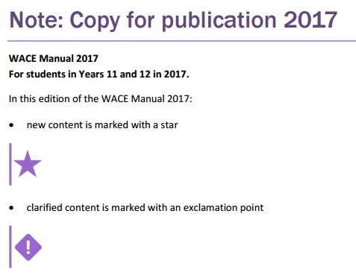
WACE Manual
Notes:
The WACE Manual 2017 (http://www.scsa.wa.edu.au/publications/wace-manual) describes policies and procedures to be followed in relation to achieving the WACE in 2017. It is produced by the School Curriculum and Standards Authority to inform principals, other school administrators, teachers, students and parents of the requirements for the WACE.
Principals should ensure that school policy documents for students who are in Year 11 and Year 12 in 2017 are consistent with information in the WACE Manual.
The Authority website and 11to12Circulars should be checked regularly for updated information about the WACE.

Slide 30
2017 Briefing for School Leaders

Slide 31
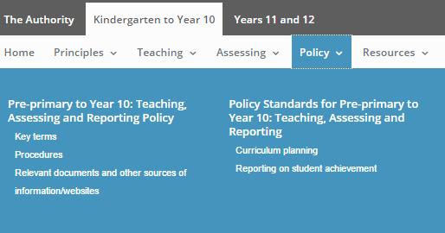
Notes:
The Pre-primary to Year 10: Teaching, Assessing and Reporting Policy and the Policy Standards for Pre-primary to Year 10: Teaching, Assessing and Reporting are accessible in the Policy section of the Western Australian Curriculum and Assessment Outline (http://k10outline.scsa.wa.edu.au/home/policy/teaching-assessing-and-reporting-policy).
The Pre-primary to Year 10: Teaching, Assessing and Reporting Policy sets out the minimum mandatory requirements for teaching the Western Australian Curriculum and for assessing and reporting student achievement.
The Policy Statement requires all schools to implement the Western Australian Curriculum and Assessment Outline (the Outline) at www.scsa.wa.edu.au to meet the learning needs of all students.
School systems/sector may prescribe further requirements.
A seven minute video, which provides an overview of the key messages requirements published in the Policy and Standards, is available in the Policy section of the Western Australian Curriculum and Assessment Outline.

Slide 32
The Western Australian Curriculum and Assessment Outline
The Outline:
sets out the knowledge, understanding, skills, values and attitudes that students are expected to acquire, and guidelines for the assessment of student achievement
is mandated for all Western Australian students
provides comprehensive information that schools can use to plan student learning programs, assess student progress and report to parents.
Notes:
Each of the eight Learning Areas have year-level syllabuses which contain the curriculum content that must be taught in each year.
The curriculum content is the Western Australian Curriculum which has been adopted and adapted from the Australian Curriculum.
Year-level Achievement Standards are identified in each syllabus. The Achievement Standard describes the expected level that the majority of students are achieving by the end of a given year of schooling. Meeting the achievement standard at a satisfactory level is described by a C grade.
New documentation from ACARA will not always support the mandated Western Australian Curriculum.

Slide 33
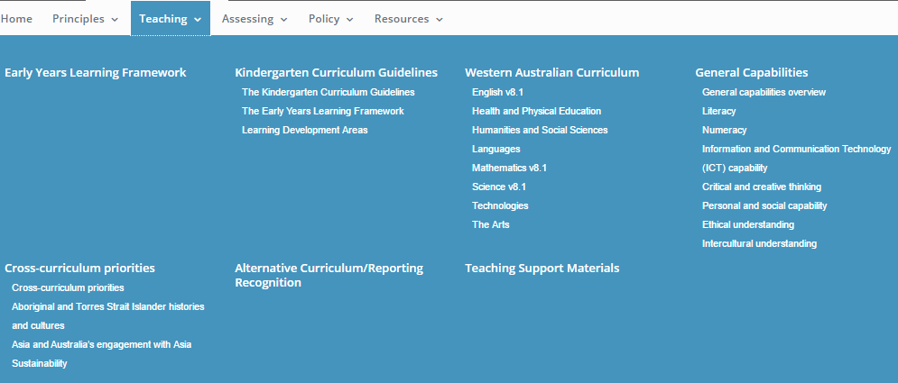
Notes:
The Western Australian Curriculum can be accessed via the Teaching menu of the Western Australian Curriculum and Assessment Outline website.
The Teaching Support Materials include sample Teaching and Learning Outlines. These exemplify the elements of a good teaching and learning program. Teachers need to consider:
the timing and sequencing of the year-level syllabus content
the range of learning experiences through which students can apply the knowledge, skills and concepts from the syllabus content
the selection of resources to support teaching and learning experiences
the implementation of the principles of teaching and learning as articulated in the Ways of Teaching in the Overview of the syllabus.
The Western Australian Curriculum has year-level syllabuses for each Learning Area. The syllabuses contain detailed information about the rationale, aims, student diversity, organization, knowledge and skills, Achievement Standards, general capabilities, cross curricular priorities, ways of teaching and ways of assessing for that Learning Area.
The Ways of Teaching in the Overview of each Learning Area outlines key questions to consider when developing a teaching and learning program and the ways of teaching diagram provides a summary of the key teaching and learning activities that challenge students’ critical thinking. These are exemplified in the Ways of Teaching video.
Notional Time Allocation Guidelines: Pre-primary to Year 10
The Notional Time Allocation Guidelines: Pre-primary to Year 10 (http://k10outline.scsa.wa.edu.au/__data/assets/pdf_file/0018/321714/Advice-on-Time-Allocation-2016.pdf) are presented as a guide. They are not mandatory and do not presume how schools should organise their students’ learning.

Slide 34
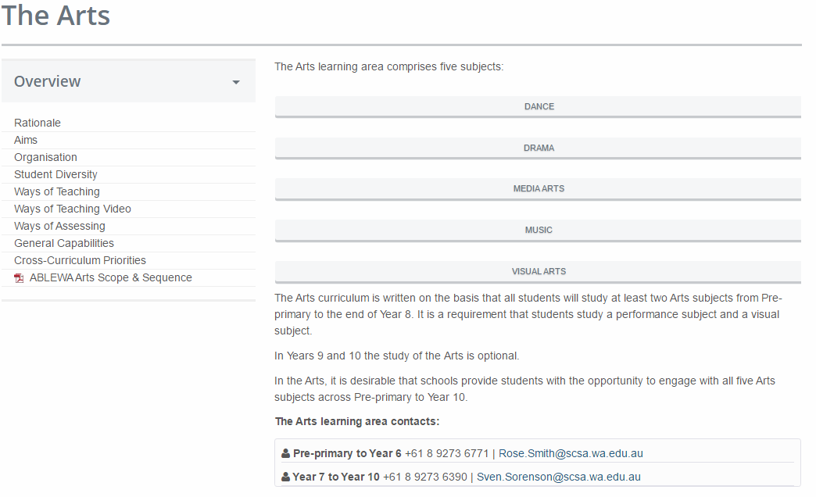
Example: Overview for The Arts
Provides an overview of the main purpose and benefits of studying the Arts
Lists (sometimes by subject) the major learning objectives throughout the P-10 teaching program
Outlines principles and strategies for transferring the knowledge and skills in the Learning Area into classroom practice, including graphics
Describes the broad way the content is structured in the Learning Area
Provides a list of suggestions and strategies for catering for different learning needs in the Learning Area
Provides examples of assessment strategies that align with the Principles of Assessment in The Outline and assist teachers with grouping content meaningfully
Outlines the opportunities for addressing the general capabilities and cross-curriculum priorities through the learning area – not a prescribed assessment item
Notes:
Each Learning Area has an Overview. As an example, this is the Overview for The Arts.
The Overview assists teachers to be come familiar with the information provided about the Learning Area.
You will note that there are some minor differences in the Overview for each Learning Area.
The Ways of Teaching and the Ways of Assessing sections of the Overview have been designed to provide teachers with practical support in the implementation of the Learning Area with a focus on supporting the development of meaningful teaching, learning and assessment programs/outlines.
In primary school, teachers are successfully exploring ways of integrating learning within a learning area and between learning areas to balance the needs of students and the challenges of a teaching and learning program in their school.
The teaching and learning programs should reflect the notional time guidelines published on the Resources section (Outline PDFs) of the Western Australian Curriculum and Assessment Outline.

Slide 35
Gentle Reminders and Points of Clarification

Slide 36
Revisions – English, Mathematics, Science
The revised curriculum for English, Maths and Science appears in the Outline ‘as is’ (V8.1) – full implementation, including teaching, assessing and reporting by schools will be in place with first reporting to parents/carers by the end of Semester 1.

Slide 37
Science
The Science syllabus consists of four sub-strands in Science Understanding which must be taught in each year:
Biological Sciences
Chemical Sciences
Earth and Environmental Sciences
Physical Sciences.
The mandated curriculum must be taught over the course of the year.
One grade is reported for student achievement in Science.
Notes:
It should be noted that Science, Technologies, Engineering and Mathematics (STEM) does not replace the teaching of Mathematics or Science in the Western Australian Curriculum and Assessment Outline. It may provide a way of connecting learning or providing a context for learning within Mathematics and Science. However, teachers are required to teach all the curriculum content in all learning areas as published in the Outline.

Slide 38
Humanities and Social Sciences
The Humanities and Social Science syllabus consists of four subjects which must be taught in each year:
Civics and Citizenship
Economics and Business
Geography
History.
The mandated curriculum must be taught over the course of the year.
One grade is reported for student achievement in Humanities and Social Science – Semester 1, 2017.
Notes:
The Humanities and Social Sciences syllabus brings together all subjects of the Learning Area.
All elements of the mandated curriculum must be taught. Schools can not decide to only teach some subjects. The subjects should be delivered with equal time allocations and are outlined within the year-level syllabuses as follows:
Pre-primary to Year 2 - Geography and History
Year 3-4 - Civics and Citizenship, Geography and History
Year 5-10 - Civics and Citizenship, Economics and Business, Geography and History.
Diagrams to support teachers around the repositioning of Humanities and Social Sciences in the Western Australia Curriculum are located in the Humanities and Social Sciences Overview within the website under the Organisation section.
Focus on concepts
these underpin the content in each year (not all concepts may appear in each year)
are developed across the years
need to be taught explicitly.
Focus on Humanities and Social Sciences skills:
need to be taught explicitly
are in two year bands, except Pre-primary
are transferable to other Learning Areas and outside the classroom.

Slide 39
Health and Physical Education
The Health and Physical Education syllabus comprises two strands: Personal, social and community health and Movement and physical activity.
Health and Physical Education is mandated from Pre-primary to Year 10.
Separate Achievement Standards for Health Education and for Physical Education.
One grade is reported for student achievement in Health – Semester 1, 2017.
One grade is reported for student achievement in Physical Education – Semester 1, 2017.
Notes:
There are diagrams designed to support teachers in relation to the organisation of the Health and Physical Education Learning Area in Western Australia.
These diagrams are located in the Health and Physical Education Overview within the website under the Organisation section.
The Learning Area consists of two distinct subjects (Health Education and Physical Education). Note the connecting skills between:
Physical Education, in primary school, the fundamental movement skills are broken up between Pre-primary to Year 4 and then in Years 5 to 6 students are applying these skills to a specific sport or in a more formal situation
in secondary school teaching the biomechanics without being in a classroom and the assessment practice for performance in Physical Education.

Slide 40
The Arts
Five subjects: Dance, Drama, Media Arts, Music and Visual Arts.
All students will study a performance subject (Dance, Drama or Music) and a visual arts subject (Media Arts or Visual Arts).
In Years 9 and 10 the study of the Arts is optional.
Desirable that schools provide students with the opportunity to engage with all five Arts subjects across Pre-primary to Year 10.
Across a year, one grade is reported for student achievement in a performance subject – Semester 1, 2018.
Across a year, one grade is reported for student achievement in a visual subject – Semester 1, 2018.
Notes:
Across a year schools report one grade (A–E) as a minimum in a performance arts subject and one grade (A–E) as a minimum in a visual arts subject:
where subjects are taught concurrently during the year two grades are required each semester
where the subjects are taught in separate semesters it is permissible to report on a Performance Arts subject in one semester and a Visual Arts subject in the other semester.

Slide 41
Technologies
Two subjects: Digital Technologies and Design and Technologies.
Design and Technologies: Engineering principles and systems; Food and fibre production; Food specialisations; Materials and technologies specialisations – students have the opportunity to study at least one of the contexts.
Desirable to engage in all contexts across Pre-primary to Year 10.
In Years 9 and 10 the study of Technologies is optional.
Across a year, one grade is reported for student achievement in Digital Technologies – Semester 1, 2018.
Across a year, one grade is reported for student achievement in Design and Technologies – Semester 1, 2018.
Notes:
All students will study both Technologies subjects from Pre-primary to the end of Year 8 (within Design and Technologies: Engineering principles and systems; Food and fibre production; Food specialisations; Materials and technologies specialisations). Students have the opportunity to study at least one of the contexts.
Across a year schools report one grade (A–E) as a minimum for Design and Technologies and one grade (A–E) as a minimum for Digital Technologies:
where subjects are taught concurrently during the year, two grades are required each semester
where the subjects are taught in separate semesters it is permissible to report on Design and Technologies in one semester and Digital Technologies in the other semester.

Slide 42
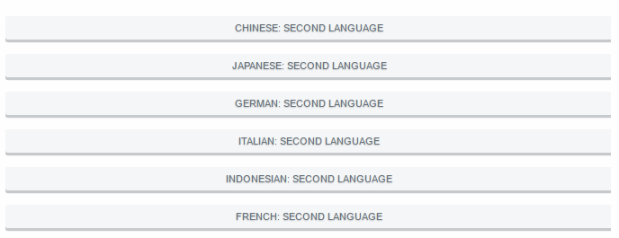
Languages
In 2018 one language for Year 3 must be implemented.
Notes:
Where possible, schools should provide Languages education from Pre-primary to Year 10. As a minimum, schools must offer:
in Years 3, 4, 5 and 6, compulsory Languages education in a minimum of one language, commencing with Year 3 in 2018 (extending to Year 4 in 2019, Year 5 in 2020 and Year 6 in 2021)
in both Years 7 and 8, compulsory Languages education in a minimum of one language, commencing with Year 7 in 2022 (and Year 8 in 2023).
In Years 9 and 10 the study of Languages is optional.
The study of one of the Aboriginal and Torres Strait Islander languages is acceptable.
Recently arrived migrants, for whom English is not their first language, may substitute English as a Second Language or further studies in English for the study of a foreign or Indigenous language.
Auslan is an acceptable alternative to the study of a language other than English.
Schools may offer a different language from those for which syllabuses are provided in the Western Australian Curriculum and Assessment Outline (e.g. Arabic, Hebrew, Hindi, Korean, Modern Greek, Vietnamese, first or background language Chinese). Where schools offer a different language (or curriculum at a different level) from those for which syllabuses are provided in the Western Australian Curriculum and Assessment Outline teachers will need to exercise their professional judgement in the adaptation of the Australian Curriculum, Assessment and Reporting Authority’s (ACARA) curriculum or alternative syllabuses.

Slide 43
Abilities Based Learning Education, Western Australia
Non-mandatory resources for teachers of students with significant intellectual disability who can’t access the P – 10 Western Australian Curriculum.
Assessment Tools
Used to identify students’ readiness to learn across three learning domains: English – Speaking and Listening; English – Reading and Writing; and Personal and Social Capability.
Curriculum
Curriculum content descriptions and Achievement Standards for Stages A to D, in all Learning Areas, except Languages.
Online Professional Learning Modules
Notes:
Further details about ABLEWA can be found within the Western Australian Curriculum and Assessment Outline (http://k10outline.scsa.wa.edu.au/home/resources/ablewa).
Should you have further questions please contact Maureen Lorimer, Principal Consultant, Strategic Projects (maureen.lorimer@scsa.wa.edu.au).

Slide 44
Intensive English Centre
There are 14 primary, secondary and post-compulsory Intensive English Centres in Perth catering for newly arrived migrant and humanitarian entrants (refugees who may commence school with limited or no English).
Language, literacy and content need to be taught according to the student’s age and year level.
Students are assessed and reported on in English, Viewing, Speaking, Listening and Writing using EAL/D Progress Map Levels.
In other curriculum areas, student achievement should be recognised but a grade does not have to be allocated. Students are regarded as being on an IEP.
Notes:
Further details about ABLEWA can be found within the Western Australian Curriculum and Assessment Outline (http://k10outline.scsa.wa.edu.au/home/resources/ablewa).
Should you have further questions please contact Maureen Lorimer, Principal Consultant, Strategic Projects (maureen.lorimer@scsa.wa.edu.au).

Slide 45
2017 Briefing for School Leaders

Slide 46
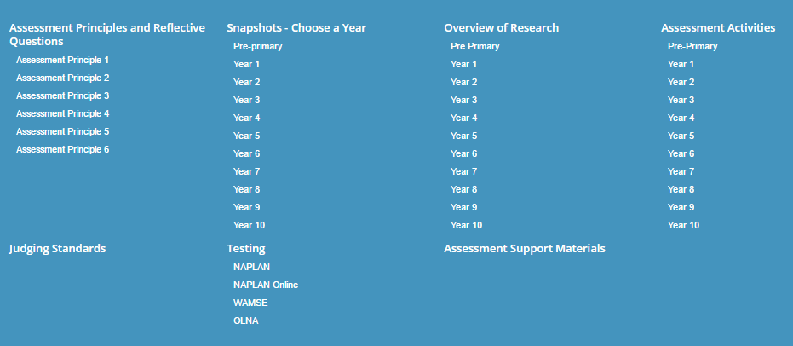
Assessing
Notes:
A range of Assessment resources can be accessed via the Assessing section of the Western Australian Curriculum and Assessment Outline.
The Assessment Snapshots illustrate the assessment principles within a classroom or school context. The contexts and observations represent what many teachers already do and serve to show that the assessment principles apply across the broad range of assessment activity from teacher observations and teacher devised assessments.
The sample Assessment Activities exemplify a broad range of strategies teachers employ to obtain information about their students' skills and understandings, and range from asking questions during a lesson to giving a formal assessment. The activities reflect the Principles of Assessment and the assessment strategies outlined in the Ways of Assessing section. A sample marking key has been provided with the tasks.
Judging Standards materials require an extranet login. Judging Standards is a resource to support teachers when reporting against the Achievement Standards for each year of schooling; when giving assessment feedback; and when explaining the differences between one student's achievement and another's. The achievement standard describes an expected level that the majority of students are achieving or working towards by the end of that year of schooling. Some students will have progressed beyond the achievement standard; others will need additional support. The expected standard for each year is described as 'C' or Satisfactory. The Assessment Pointers, in conjunction with the student work samples, identify performance above (A and B) and below the standard (D and E).

Slide 47
Update on Judging Standards
Available on the extranet with a login:
English, Mathematics and Science revised to reflect v8.1 of the curriculum
Mathematics and Science are available now
English Assessment Pointers will be available – end of Term 1
Annotated Work Samples for the Arts and English will be progressively uploaded during Semester 1
Humanities and Social Sciences, Health and Physical Education and Technologies are available now.
Notes:
The Judging Standards resources comprise three, interrelated components:
A Grade describes student achievement on a five-point scale and is used for the purpose of reporting student achievement. Individual assessments should be graded.
An Achievement Descriptor describes student achievement in terms of a five-point scale and is used for the purpose of reporting student achievement.
Assessment pointers assists teachers to validate their professional judgement when reporting against a five-point scale. The pointers are examples of evidence in relation to the achievement standard; should be used with the annotated work samples; and, exemplify what students may demonstrate rather than a checklist of everything they should do. In some Learning Areas, depending on what has been taught in the reporting period, teachers may refer to only a selection of the pointers in one or more of the subjects and/or contexts of the Learning Area.
Annotated work samples support teachers when reporting against the achievement standard; when explaining the differences between one student’s achievement and another’s; and, in implementing internal moderation practices. Moderation for Reporting focuses on those aspects of assessment where schools are required to be accountable for student performance and where it is important that teacher judgements are comparable. When undertaking moderation for reporting purposes, the emphasis is on broad classifications of student performance (e.g. reporting student performance in terms of grades or in terms of achieving the standard), and ensuring teachers have consistent interpretations of these broad classifications (Western Australian Curriculum and Assessment Outline, Assessment Principle 5 - Assessment should lead to informative reporting).
Judging Standards materials (Assessment Pointers) for Pre-primary to Year 10 Mathematics and Science have been revised to align with v8.1 of the Australian Curriculum, incorporating teacher feedback.
The Authority has worked with teachers using student work samples to refine the pointers. These are available through the extranet.
The English assessment pointers are being finalised, and student work samples are being collected for annotation. The English assessment pointers will be available at the end of Term 1.

Slide 48
Teacher Support Materials
Teaching | Assessing
Ways of Teaching principles and diagram in the Overview for each Learning Area Ways of Teaching video in the Overview for each Learning Area Sample Teaching and Learning Outlines in Teaching Support Materials | Ways of Assessing Assessment Snapshots Sample Assessment Activities including marking keys Judging Standards Materials – the Achievement Standards, Assessment Pointers and Annotated Work Samples
Notes:
For implementation of HASS AND HPE and familiarisation for The Arts and HPE and some teacher support materials for Years 1-3 for Languages available in Semester 1, 2017.\
Judging Standards for P-6 for Languages in Semester 1, 2017.
Technologies Judging Standards are all available online.
Two assessment activities in Digital in Primary and Secondary.
Two design and technology in secondary and primary.
Teaching and Learning Outlines in Tech for PS and Secondary
Arts – Judging Standards – Assessment Pointers are now online for all five arts subjects P-10. Annotated samples will come online by the end of Semester 1.
Drama and Dance for PS and Secondary – sample teaching and learning outlines will be released soon . Assessment Activities will also be uploaded this Semester for teachers.
Full suite in HASS materials are live.

Slide 49
Moderation Pilot – Years 6 and 7
The purpose of the Authority’s moderation pilot in English and Mathematics is to support schools with:
appropriately delivering the syllabus
correctly implementing the Authority’s assessment requirements
using Judging Standards to inform teacher judgements
assign grades that are comparable with state-wide standards for the Learning Area/subject/context.
Notes:
Schools, from across systems/sector in two networks (north and south), and one regional network, will be invited to participate in a moderation pilot activity for English and Mathematics in Year 6 and Year 7.
The moderation process is designed to provide a shared understanding of the standard in Year 6 and Year 7 in English and Mathematics and to look at the comparability of judgements in assessments.

Slide 50
Moderation Pilot – Years 6 and 7
Schools, from across school systems/sector in two networks (north and south), and one regional network, will be invited to participate in a moderation pilot for English and Mathematics.
In Term 1, participating schools will be provided with an assessment task to complete along with a marking key. The pilot will commence in Term 2.
Teachers will be asked to bring along student work samples to the meeting.
Notes:
Further details will be published via the Kto10 Circular.

Slide 51
Pre-primary to Year 10 Syllabus Review
Review process subsequent to Years 11 and 12 review.
More time to ‘bed down’ curriculum content delivery and teacher understandings.
The review process will be cautious and circumspect.
Notes:
It is proposed that the Pre-primary to Year 10 syllabus review process will occur in phases and will be cyclical on a five-year basis.
Any review process will have four stages.
an initial collection of advice from all key players related to the nature and degree of change
an assessment of and follow up response by the Board to analysis of advice from all key stakeholders
research and rewriting of syllabus curriculum content where required
review of syllabus support materials where required.

Slide 52
2017 Briefing for School Leaders

Slide 53
NAPLAN Online
99 Western Australian schools will move online in 2017.
All schools will move online by 2019.
Expressions of interest called for by the Department of Education, Catholic Education and Independent Schools Association from schools wishing to participate in 2018.
School, teacher and student readiness will be assessed with the intention of inviting 400 schools to transition in 2018.
Notes:
Resources
National Assessment Program, NAPLAN Online website.
Research and development – details on tailored tests, automated essay scoring, device suitability, student engagement and motivation, readability and layout, accessibility options: https://www.nap.edu.au/online-assessment/research-and-development.
The Authority’s NAPLAN Online website: http://k10outline.scsa.wa.edu.au/home/assessment/testing/naplan-online.

Slide 54
NAPLAN Online – Readiness for Transition
School readiness – check technical capacity for students to undertake assessment in testing window.
Teacher readiness – test administration within defined test session (i.e. class logistics, minor device management).
Student readiness – sufficient knowledge and familiarity with device to undertake the assessment.
The Authority’s NAPLAN Online website: http://k10outline.scsa.wa.edu.au/home/assessment/testing/naplan-online.
Notes:
Readiness for Transition
Need to consider:
School readiness – sufficient devices, bandwidth, technical awareness
Staff readiness – awareness of changes, training requirements
Student readiness – exposure to ICT and English curriculum, familiarity with devices
School community readiness – have you communicated your intentions to transition to parents? The public demonstration site is a good place to begin. Fact sheets aimed at parents will be rolled out over this year.

Slide 55
2017 NAPLAN Dates
NAPLAN Paper Tests: 9 – 11 May
Tuesday 9 May: Writing, Language Conventions
Wednesday 10 May: Reading
Thursday 11 May: Numeracy
NAPLAN Online Tests: 9 – 19 May
http://scsa.wa.edu.au/publications/activities-schedule

Slide 56
2017 – Business as Usual for Most Schools
Reading to students
All Year 3 students will complete Writing with pen and paper
Calculator (Numeracy Years 7 and 9)
Hosting students
Additional detail on these changes are in the Handbook for Principals and Test Administration Handbooks – Years 3, 5, 7 and 9.
Notes:
Reading to students: online test has an audio facility for reading and numeracy test questions, which any student can access. Test administrators of paper tests will now be able to read numerals and symbols which are embedded in text.
Year 3 Writing: Education Council will revisit discussions on the viability of Year 3 students completing any future Writing assessments online in the second half of 2017.
Calculator (Numeracy Years 7 and 9): one 60 minute test: the Calculator Allowed section will be conducted first. After 50 minutes calculators will be collected and students will then have 10 minutes to complete the Non‐calculator section. (As used to happen in WALNA!).
Hosting students: before accepting to host a student from interstate or elsewhere in Western Australia for NAPLAN you will need to ascertain whether their home school is doing the same mode of testing as your school. Any student from your school that requires a host school must find one offering the same mode of delivery. Paper schools cannot offer online delivery and vice versa.

Slide 57
Basic Differences
Complete the test on computers or tablets with the exception Braille. They need headphones.
No paper tests from 2019.
Students sit the same number of test questions but may take different pathways through the tailored test design.
Test window extends for 9 days; with a third week for exceptional circumstances.
Order of tests: Writing, Reading, Conventions of Language, Numeracy.
Initial reporting to schools and parents will be 3 weeks after the end of the test security period – before the end of Term 2.
Audio will be used for Spelling and to listen to the Writing prompt and Numeracy questions where required.

