Slide 1
ATAR and General English
Trim: 2014/24089v2
1

Slide 2
Webinar process
The webinar is divided into three sections:
Content
Assessment
Examinations
Questions related to other matters are best addressed to info@scsa.wa.edu.au
2

Slide 3
Webinar process
In preparation for the webinar it is expected that participants will have:
reviewed the relevant course/s
watched the WACE 2015-16 overview video and relevant learning area video
read the ‘What changes’ document for the relevant course
read the FAQ document about changes to the WACE for 2015-16.
read the English specific information at: http://wace1516.scsa.wa.edu.au/english/
3

Slide 4
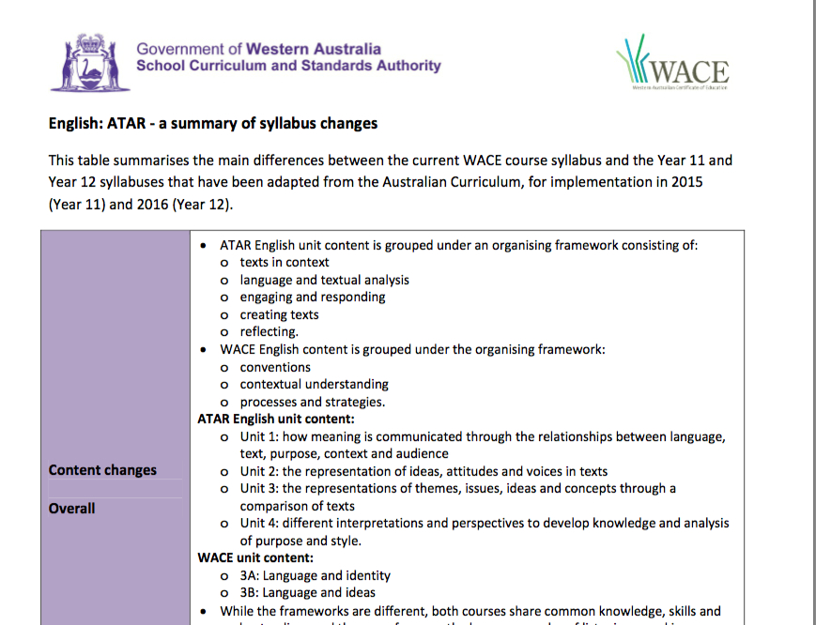
Webinar process
Many of the details in today’s webinar are contained in the “changes” summary for each English course.
4

Slide 5
How has the content changed?
The WACE English courses and the Australian Curriculum ATAR and General English courses both share common knowledge, skills and understandings and a similar focus on the language modes of listening, speaking, reading, viewing and writing.
There are however different emphases in the Australian Curriculum courses compared to our WACE courses.
5

Slide 6
How has the content changed?
Wordle (http://www.wordle.net) will be used to compare courses as word clouds. (A word cloud is a diagrammatic representation by size, of the word frequency of the text copied in.)
Each word cloud consists of the unit content description and unit content dot points of the particular course.
6

Slide 7
Summary of differences before direct comparison of courses:
An apparent focus shift from “language” to “texts”
Greater emphasis on multimodal digital/online and hybrid texts in both AC courses
Some key terminology in ATAR English that does not occur in WACE courses
Increased focus on the creation of analytical, imaginative, interpretive and persuasive responses in ATAR English
7

Slide 8
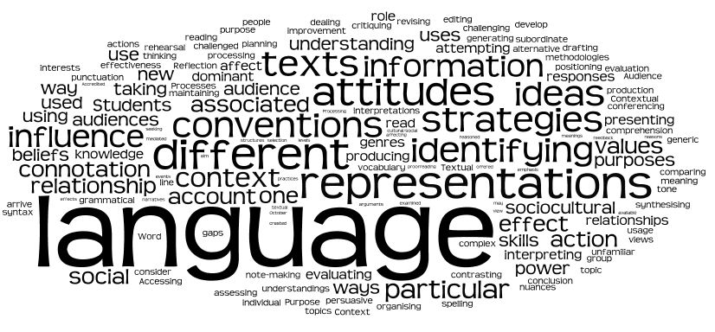
WACE Stage 2 (ENG 2A/2D)
8

Slide 9
11 ATAR English
9

Slide 10
11 ATAR English - differences
10

Slide 11
11 ATAR English – differences
Apart from the clear texts/language difference in the word clouds (covered in later slides) there are many clear connections between the two courses.
The terminology differences from the word cloud model are:
perspectives, voice, multimodal, metalanguage, medium, and media.
11

Slide 12
1 1 ATAR English - similarities
Comparing the WACE Stage 2 and ATAR 11 word clouds, the courses have significantly more in common than they have differences.
12

Slide 13
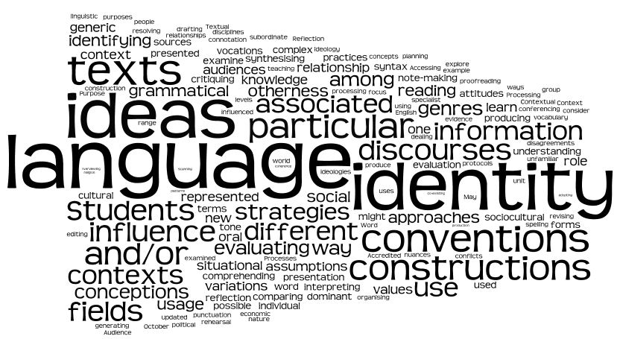
WACE Stage 3 (English 3AB)
13
Notes:
.

Slide 14
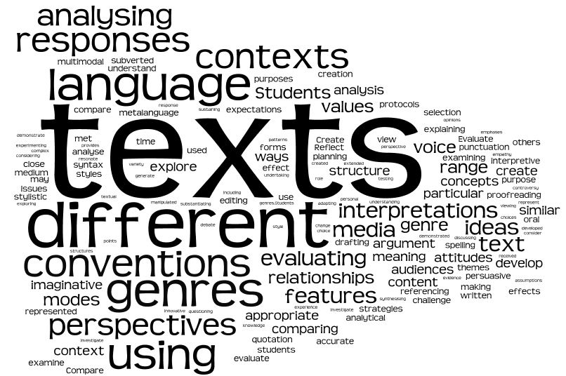
12 ATAR English
14

Slide 15
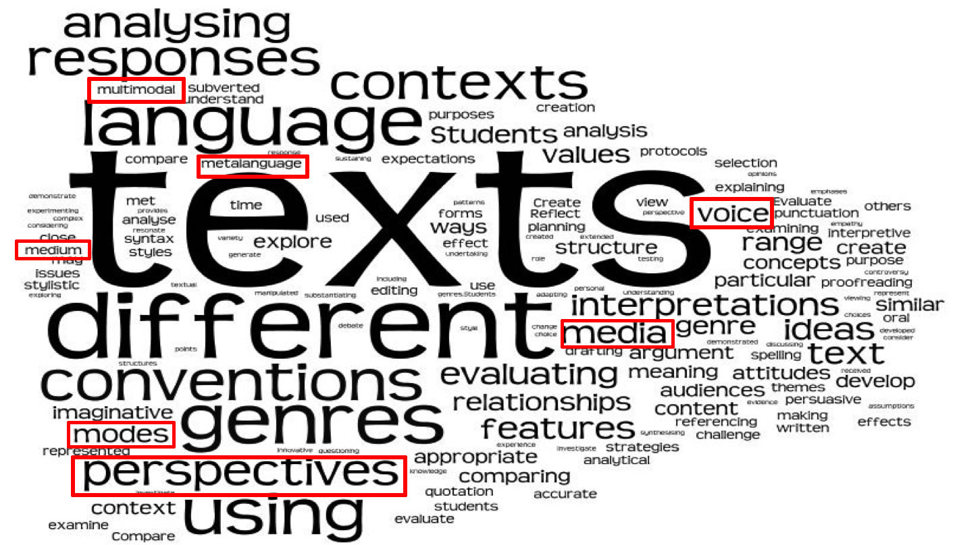
12 ATAR English - differences
15

Slide 16
12 ATAR English : how has the content changed?
Apart from the term “identity” (3A), there are many clear connections between the two courses.
The terminology differences from the word cloud model are:
perspectives, voice, multimodal, metalanguage, medium, media and modes.
16

Slide 17
12 ATAR English : how has the content changed?
Although these terms are not used extensively in current WACE courses, they should be familiar to teachers.
The terms metalanguage and mode/s are used throughout the Australian Curriculum F-10 syllabus.
17

Slide 18
General English: how has the content changed?
As with the ATAR / WACE English courses, WACE English Stage 1CD and Stage 2AB/2CD and the AC General English course share common knowledge, skills and understandings and a similar focus on the language modes of listening, speaking, reading, viewing and writing.
18

Slide 19
General English: how has the content changed?
Collated WA feedback voiced a concern that the needs of the lower 10%-20% of the English cohort were not being met in the original AC Essential English course. This has been addressed with the writing of Preliminary and Foundation courses to address these needs.
19

Slide 20
General English: how has the content changed?
As with ATAR English, the General English course focuses on a wide range of text forms, with greater emphasis on multimodal and digital/online texts compared to current WACE English.
The content organiser Communicating and interacting with others has been added to the General English course to ensure students develop the ability to work collaboratively and interact confidently, as stated in the course Aims.
There is a unit content dot point elaboration under this heading for each unit.
Oral language and listening skills are also profiled.
20

Slide 21
General English: how has the content changed?
There is contextual emphasis in the General English course to “focus and consolidate skills and knowledge .. for everyday, community, social, further education, training and workplace contexts”.
See the additional reference under Texts page 4 of the General syllabus to workplace texts, with examples provided. Note that this list is not exclusive.
21

Slide 22
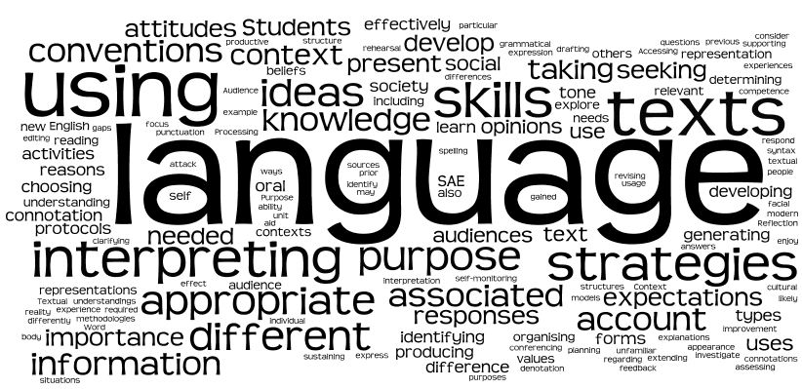
WACE Stage 1 (ENG 1CD)
22

Slide 23
11 General English
23

Slide 24
11 General English - differences
24

Slide 25
11 General English - differences
As with the ATAR courses there are more similarities than differences.
It is worth noting the increased emphasis in the General 11 course on the contexts of community, workplace, education, training, as well as the interpersonal elements of interacting, social and others.
Other differences include the terms modes, media, multimodal and visual.
25

Slide 26
WACE Stage 2 (ENG 2A/2D)
26
Notes:
.

Slide 27
12 General English
27

Slide 28
12 General English - differences
28

Slide 29
12 General English - differences
As with General 11 there is a change in context focus – the notions of workplace, interviews, communicating, oral, cooperation, everyday texts.
Terminology differences: perspectives (significant), voice and the greater focus already identified on multimodal, visual and media elements.
Greater emphasis on communicating and the modes ‘oral’, ‘visual’ and ‘listening’ (it’s there).
29

Slide 30
General English: how has the content changed?
Overall the common changes to the General course are :
apparent text/language focus difference
greater emphasis on digital technologies
some new or less familiar key terminology
context focus shift – everyday, social, workplace, further education etc
students collaborating, interacting.
30

Slide 31
ATAR and General English overview - how has the content changed?
An apparent focus shift from “language” to “texts”.
Greater emphasis on multimodal digital/online and hybrid texts in both AC courses.
Some key terminology in ATAR English that does not occur in WACE courses.
Increased focus on the creation of analytical, imaginative, interpretive and persuasive responses in ATAR English.
31

Slide 32
Overview – how has content changed?
1. Apparent shift of focus from ‘language’ to ‘texts’
Where WACE courses tend to refer to language (note that the word ‘texts’ is still quite large in the ATAR word cloud), the AC use of text in both ATAR and General English courses is referencing the language of a wide range of text forms and types. The course is still about language. (Slides 39-43 expand on this).
AC English courses do not distinguish between visual and written texts, nor between written language or visual language. All texts have particular text language features, structures, stylistic choices and conventions.
32

Slide 33
Overview – how has the content changed?
2. Use of key terminology not found in WACE courses
The terms ‘perspective/s’ and ‘voice/s’ are used comprehensively in both AC courses. Potential ambiguity with other terms:
perspective/s
voice/s
point of view
opinion
viewpoint
33

Slide 34
Overview – how has content changed?
2. (cont’d) Use of key terminology not found in current WACE courses
While the term ‘perspective/s’ doesn’t occur in any of the current WACE syllabuses, it is used comprehensively throughout the Australian Curriculum: English F-10 curriculum as well as the General and ATAR English courses.
34

Slide 35
Overview – how has content changed?
2. (cont’d) Use of key terminology not found in current WACE courses
Although defined in the glossary, it is important that teachers clearly distinguish, where appropriate, between these terms. For example “students explore relationships between voice and perspectives”, and another, “using personal voice and adopting different points of view and/or perspectives to influence audiences in a range of media”.
It is also important for teachers to clarify for their students the distinction between ‘point of view’ and ‘narrative point of view’. This is sometimes a contextual matter (where and how the term is used).
35

Slide 36
Overview – how has content changed?
3. Multimodal, digital/online and hybrid texts.
The new ATAR and General English courses require teachers to have particular knowledge, skills and understandings in digital technologies, and their schools, the hardware and software to deliver the required curriculum content.
Students are required to respond to and/or create multimodal, digital/online texts and hybrid texts and ‘experiment with multimodal devices’ – elements embedded in AC English F-10 syllabus.
36

Slide 37
Texts – See page 4 of all ATAR and General syllabuses:
Texts
Texts for the English ATAR course include literary texts (see glossary definition) and non-literary texts:
fiction – novels, short stories, fables, fairy tales, plays, poems, song lyrics, films, television programs, comic books, computer games
non-fiction – biographies, journals, essays, speeches, reference books, news reports, documentaries, photographs, diagrams
media texts – newspaper articles, magazine articles, editorials, web sites, CD-ROMs, advertisements, documentaries, photographs, television programs, radio programs
everyday texts – blogs, films, television programs, comic books, computer games, manuals
workplace texts – reports, minutes, application forms, safety regulations, technical manuals, pamphlets, memos, letters and on-line digital texts.
37

Slide 38
Texts – See page 4 of all ATAR and General syllabuses:
Texts (cont’d)
Texts will be drawn from increasingly complex and unfamiliar settings, ranging from the everyday language of personal experience to more abstract, specialised and technical language drawn from a range of contexts. Texts provide important opportunities for learning about aspects of human experience and about aesthetic appeal.
Texts can be written, spoken (dialogues, speeches, monologues, conversations, radio programs, interviews, lectures), multimodal (picture books, graphic novels, web pages, films, television programs, performances, advertisements, cartoons, music videos, computer games, maps) and in print or digital/online (books, CD-ROMs, websites, computer games, social networking sites, email, SMS, apps).
Texts are structured for particular purposes, for example, to retell, to instruct, to entertain, to explain and to argue. Teachers may select whole texts and/or parts of texts depending on units of study, cohorts and level of difficulty.
38

Slide 39
Texts
The textual focus in the ATAR and General English courses is comprehensive, spanning the breadth of language modes, text forms and text types.
Teachers should be clear on text-related terminology (see Appendix 2 – Glossary):
Digital texts
Form; forms of texts
Hybrid texts
Literary texts
Media texts
Mode
Multimodal text
Types of texts
39

Slide 40
Texts
A range of forms of literary and non-literary texts is provided on page 4 with examples for each:
fiction
non-fiction
media texts
everyday texts
workplace texts (General only).
Note: the list is qualified with the word “includes” ie there are text forms not included such as autobiography and memoir in non-fiction.
In addition “teachers may select whole texts or parts of texts”.
40

Slide 41
Texts
Extract from the Australian Curriculum English F-10 (Yr 10 Literacy page 92)
“Students engage with a variety of texts for enjoyment. They interpret, create, evaluate, discuss and perform a wide range of literary texts in which the primary purpose is aesthetic, as well as texts designed to inform and persuade. These include various types of media texts, including newspapers, film and digital texts, fiction, nonfiction, poetry, dramatic performances and multimodal texts, with themes and issues involving levels of abstraction, higher order reasoning and intertextual references. Students develop critical understanding of the contemporary media, and the differences between media texts.”
41

Slide 42
Texts
While challenging for a range of reasons, greater textual breadth in the ATAR and General English syllabuses can be viewed positively:
expands teaching/learning opportunities
teachers no longer constrained to teach only certain texts for certain courses
students not penalised for using incorrect texts in WACE examination
greater choice and flexibility regarding what texts or parts of texts to teach
if the course content is covered, students will be equipped with the knowledge and understanding of how language and conventions operate to be able to respond to a broad range of texts.
End of Content Change section
42

Slide 43
ATAR English – how has assessment changed?
43

Slide 44
ATAR and General English – oral
Please refer to the assessment table in any of your ATAR or General syllabus documents. For both ATAR and General English note that the assessment table does not include a mandatory oral production / creation component.
The assessment outline must include a speaking/listening assessment at least twice for the pair of units or once for a single unit where only one is being studied (Year 11) or at least twice for the pair of units (Year 12). The weighting for this assessment is not mandated for either course.
The spirit of this requirement is that all of the language modes of listening, speaking, reading viewing and writing are taught and assessed in both courses.
44

Slide 45
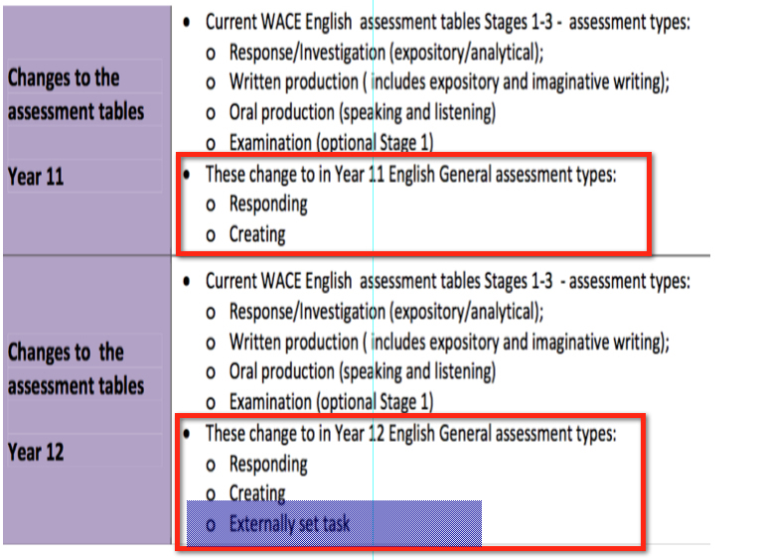
General English – how has assessment changed?
45

Slide 46
Changes to assessment type weightings: ATAR English
46

Slide 47
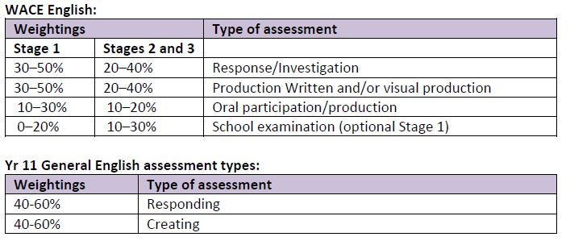
Changes to assessment type weightings: General English Year 11
47

Slide 48
Changes to assessment type weightings: General English Year 12
48

Slide 49
What is the role of the EST?
The Externally Set Task (EST) process will support consensus moderation to ensure that a C grade in one school is the same as a C grade from every other school. The EST process will:
have an educative role in establishing common understandings of course standards and related content
provide access to feedback which will encourage teachers to review and where appropriate adjust their marking, assessment and teaching
model best assessment practice which teachers can apply to other school-based assessment tasks
enable analysis by the Authority across schools and/or courses
inform the Authority’s selection of schools for which grading reviews will be conducted
enhance public confidence in school-based grades for these non-examination courses and maintain the credibility of certification.
49

Slide 50
What is the role of the EST?
Purpose - An Externally Set Task (EST) process will be introduced for General courses (including Foundation courses but excluding Preliminary courses) at Year 12 and will be used for consensus moderation. On a rotation basis, schools will be required to submit marks and a sample of scripts to the Authority for validation of marks.
These processes will inform moderation visits the following year.
Administration – the task will be approximately 60 minutes in duration and be completed individually by students under test conditions.
Sample - available on the website - WACE 2015-16 English course page.
End of Assessment Change section
50

Slide 51
How has the ATAR English examination changed?
51

Slide 52
How has the ATAR English examination changed?
Design brief: Section 1 - Comprehension
Questions require students to comprehend and analyse unseen and written texts and respond concisely.
The intention behind the structuring of this section is to elicit targeted, short answer responses from students. It is designed to assess a different written response skill-set to the other sections in the examination.
52

Slide 53
How has the ATAR English examination changed?
Section 1 could consist of one unit content dot point per question:
Briefly explain how Text 1 conforms to or challenges the conventions of a particular genre. (Unit 3)
Examine how Text 2 relates to a particular context. (Unit 4)
Discuss how one text offers a perspective through the selection of ONE of the following: (Unit 4)
mode
medium
genre
type of text.
The texts chosen could be such that students are required to refer to one text for all questions or may have to refer to two/three texts. (“Stimulus material.. two or three texts..” - Examination design brief Section 1.)
53

Slide 54
How has the ATAR English examination changed?
Design brief: Section 2 - Responding
The focus here is for students to demonstrate analytical and critical thinking skills in relation to studied texts.
This section has no text type requirements regarding types of texts students may or may not refer to, as in the current WACE exams, although some questions may require response to a particular text type.
54

Slide 55
How has the ATAR English examination changed?
Design brief: Section 3 - Composing
Students choose forms of writing to demonstrate their writing skills, requiring them to create sustained imaginative, interpretive and persuasive texts.
Questions are not related to texts studied, however students may choose to refer to texts where relevant to a question.
End ATAR English exam section
55

Slide 56
Sample exam and design brief
The structure and in a sense the content of the examination is determined by the exam design brief.
The questions in the sample paper are interpretations of the design brief. This is not to say that an exam panel is going to ask the same sorts of questions.
56

Slide 57
Sample exam Section 1
SAMPLE EXAMINATION 3 ENGLISH
Section One: Comprehending 30% (40 Marks)
In this section, there are three texts and three questions. Answer all questions.
You are required to comprehend and analyse unseen written and visual texts and respond concisely in approximately 200–300 words for each question.
The questions are of equal weighting.
Suggested working time: 60 minutes.
Question 1 (12 marks)
Identify the three shifts in narrative point of view in Text 1 and explain how each gives a particular perspective on the city of Troy.
Question 2 (12 marks)
Compare the details of setting in Texts 1 and 2 that present similar and different ideas about the city of Troy.
Question 3 (16 marks)
Identify three visual conventions used in Text 3 and explain how they construct the magazine’s representation of family.
57

Slide 58
Sample exam Section 1
While the marks allocated for questions in the sample paper are not all the same with Question 1 worth 12 marks, Question 2 worth 12 marks and Question 3 worth 16 marks, the questions are equally weighted (10%, 10% and 10%).
Marks are apportioned to key points in the answer and these do not always tally equally for each question.
58

Slide 59
Sample exam Section 1
The responses required are short answer responses. From the glossary:
“Well-developed paragraph or paragraphs in Standard Australian English which include supporting detail and typically ranging between 200-300 words depending on time allocation. While not required to conform to the conventions of formal essay writing, short answer responses should be succinct and directly address the question.”
59

Slide 60
Sample exam Sections 2 and 3
Worth noting in the sample paper Section 2 and Section 3 are the similarities to current WACE examination questions.
While questions are not directly related to texts studied in Section 3, students may choose to refer to texts where appropriate.
Images from previous papers have had to be used in the sample paper for copyright reasons.
End Exam Changes section
60

Slide 61
The English syllabuses also contain:
General capabilities
Cross-curriculum priorities
Grade descriptions
Separate glossaries for the ATAR and General courses.
Suggested text lists for ATAR and General English will be available as separate documents on the English course page.
61

Slide 62
English support materials available on the SCSA WACE 2015/16 website
ATAR summary of syllabus changes
ATAR sample examination
ATAR sample examination marking key
General summary of syllabus changes
General externally set task (EST)
General externally set task marking key
The suggested text lists for ATAR and General English will be available in Term 3, 2014.
62

Slide 63
Other support:
On the SCSA website under the WACE section:
Guide to grades
Standards guides
Suggested text list
Email for Principal Consultant, English
john.watson@scsa.wa.edu.au
63

Slide 64
Webinar Questions and Answers
ASSESSMENT TYPES and WEIGHTINGS
Q: The ATAR summary of changes document indicates that for Year 11 the assessment types are Responding and Creating. The document does not say 'Examination' in this section (bottom of page one). However, it Includes Examination in the Weighting section of this same document at Year 11. Can you clarify this?
A: The dot point ‘Examination’ at the bottom of the page was omitted in the initial summary of change document. The current online document has been amended and now includes ‘Examination’.
Q: There is an indication in the Sample ATAR English Examination that students will be 'penalised' if they don't adhere to instructions regarding a section. Will students be 'penalised 'if they go beyond the word limit stipulated in the Comprehending Section?
A: The intention in this section is for students to demonstrate short, targeted writing. The candidate is to respond in approximately 200-300 words. Students should adhere to this guide.
Q: Why do we have fixed weightings for the Year 12 ATAR English courses as opposed to having a range for particular task types?
A: All Year 12 WACE courses have fixed weightings to improve comparability across the state.

Slide 65
Question and Answers
EXAM
Q: Will all text types/ a good variety be used in the exam (unseen sections)?
A: There will be no poetry or drama. Please see the Exam Design Brief page 15 in the syllabus.
Q: In the responding section could they refer to a poem?
A: The design brief states that for the Responding section students can refer to any text or text type studied.
Q: I like the new format of the exam, although I am concerned that section 1 relies too heavily on conventions related to specific text types - unless I have misunderstood, this may be problematic in that there is no demand to cover ALL text types as stipulated in the syllabus?
A: While the choice of questions will ultimately be determined by the examination panel, the SCSA examination review process ensures that there is a thorough and comprehensive scrutiny of the paper to ensure that all questions are fair and valid.
Q: In general usage does ‘compare’ also mean ‘contrast’ - as we assume it does in Q2 Comprehending?
A: The word/ phrase ‘compare’ or ‘compare and contrast’ both refer to noting the ‘similarity or dissimilarity between’, so yes compare and contrast can be seen as redundant. However, the syllabus uses both terms in Unit 3 ‘compare and contrast distinctive features of genres by…’ so both terms have been used in the sample paper.

Slide 66
Webinar Question and Answers
EXAM (Continued)
Q: Would a statement of intent in an examination response still be recommended for the composing section?
A: Depending on the question. If a statement of intent clarifies the nature of the response for the marker (or for the candidate) then it would seem to be useful. Statements of intent are not mandatory.
Q: How will the students' study of mulitmodal texts be incorporated into the Year 12 examination? If they are able to discuss/analyse/reference it as one of the texts they have studied, when will we be able to see an example of a good response?
A: Students may refer to multimodal texts studied in Sections 2 or 3 of the exam, depending on the question chosen.
EST
Q: The Year 11 General and Year 12 General classes have an externally set task. The year 12 ATAR course has the WACE exams. What is the Year 11 ATAR equivalent for this moderation assessment?
A: Only Year 12 General has an externally set task requirement. Year 11 ATAR will be moderated by the usual process of school visits, consensus meetings and documentation reviews.
Q: How far before the EST scheduled date will teachers receive the task?
A: The EST to be used in 2016 will be developed in late 2015/early 2016. The final version of the EST’s and the marking keys will be made available for schools to administer in an Authority nominated period of two weeks in Term 2, 2016.

Slide 67
Webinar Question and Answers
MISCELLANEOUS
Q: Will SCSA provide sample programs, outlines and tasks as the Curriculum Council did with the introduction of the current Courses of Study?
A: Sample Course Outlines, Assessment Outlines and Assessment Tasks with marking keys are being prepared. Teacher Support Materials will not include programs.
Q: Is there any prerequisite for Yr 12 ATAR English to do Year 11 ATAR English? Can they do Yr 11 Lit and pair this with Yr 12 ATAR English?
A: There is no pre-requisite for year 12 English. Students may opt to change from year 11 Literature into Year 12 English.
Q: Can students do two English courses in Year 12?
A: Students may do this if they choose, but need to be mindful on how this will impact on their meeting all the requirements for achieving the WACE.
Q: Can students do Year 11 English, then do Year 12 Literature plus Year 12 ATAR English?
A: Yes. For WACE certification students are required to complete two Yr 11 units of either English, EALD or Literature and complete a pair of Yr 12 units in English, EALD or Literature. There is no requirement that the courses are the same across Years 11 and 12.

